Slide 1

Electronic Terrain and Obstacle Database
“Preparedness and Challenges”
Presented By

Slide 2
Linkages of Digital Datasets
AIP
DATA
End User Application
Micro (Survey)
Aeronautical Charts
Obstacle monitoring
Macro (Satellite Image, Lidar, Drone)
Aerodrome Mapping
Terrain
Accuracy
Integrity / Security
Obstacle
Distribution
Information
Instrument flight procedure
Layers
Metadata
Plate 1

Slide 3
Data to Information (Intelligent Data)
Data
Traditional Survey
Other Technologies
Stereo Satellite Imagery, Lidar, Drone
Ground Control Point
Location, Attribute
Raster
Vector
AIP
Pixel
Spatial
Non - Spatial
DEM
Z -Value
Point
Manual
DTM
Obstacle Type
Paper Charts / toposheets
Line
DSM
Obstacle identifier
Polygon
Integrity
Accuracy
Digitization , Schema
Join Attributes, Projection System, Metadata, Contour – SOI Toposheet
Resolution
Automatic Generated
Digital Data
Schema, Metadata
Raster
Vector
Format(.tiff, .Geotiff)
Format (.shp, kml .AIXM)
Plate 2

Slide 4
Source
Format
Accuracy/ (Resolution)
Metadata
Reference System
Traceability
Coverage
Temporality
Spatial Data
Geometry
Plate 3

Slide 5


Metadata
Plate 4

Slide 6
Comparison of Data Formats (.shp, .kml, AIXM)
ICAO is recognizing AIXM (current latest version being AIXM 5.1) as a conformity mean to serve and share obstacle data (part of ETOD) with stakeholders
For the same ETOD data, SHP and kml formats may be used within a structured framework; a prerequisite being first to clearly and precisely define a conceptual data model leveraging them.
In other words, such formats are pretty useful to convey ETOD information, provided Conceptual data model, features and meta data are defined first in order to expose the obstacle data within these two formats.
AIXM on the one hand is already a structured format to receive, manage and expose ETOD data but will require specific aeronautical viewer and editor tools in order to visualize and regularly manage and maintain with temporality the data, such tool including an AIXM database capacity with import/export possibilities.
SHP and KML on the other hand are a very accessible mean and vector to share and visualize the data : SHP is standard format for Geographical Information and KML is leveraged by Google Earth.
Plate 5

Slide 7
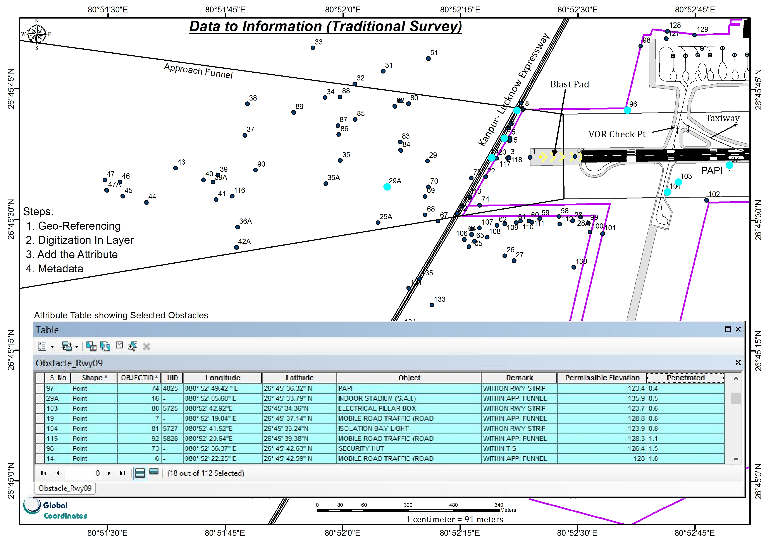
Plate 6

Slide 8
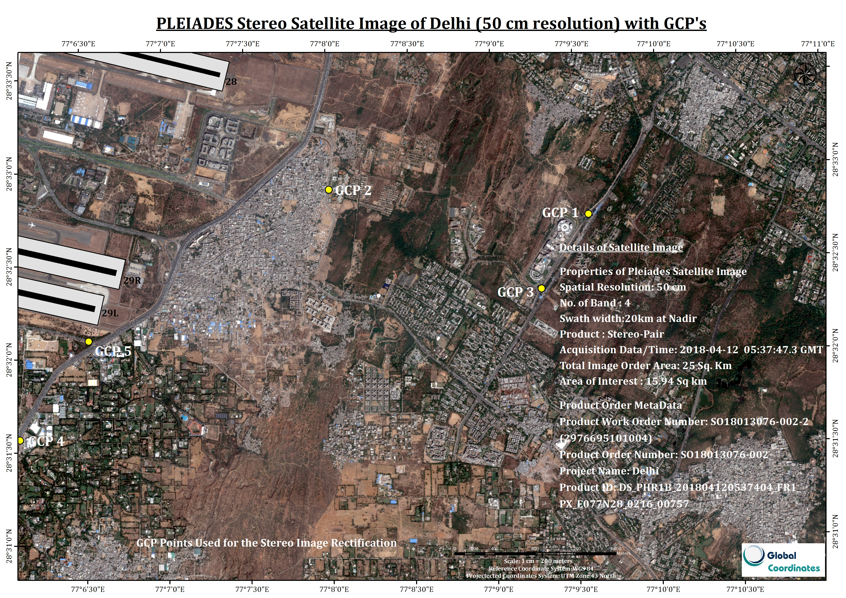
Plate 7

Slide 9
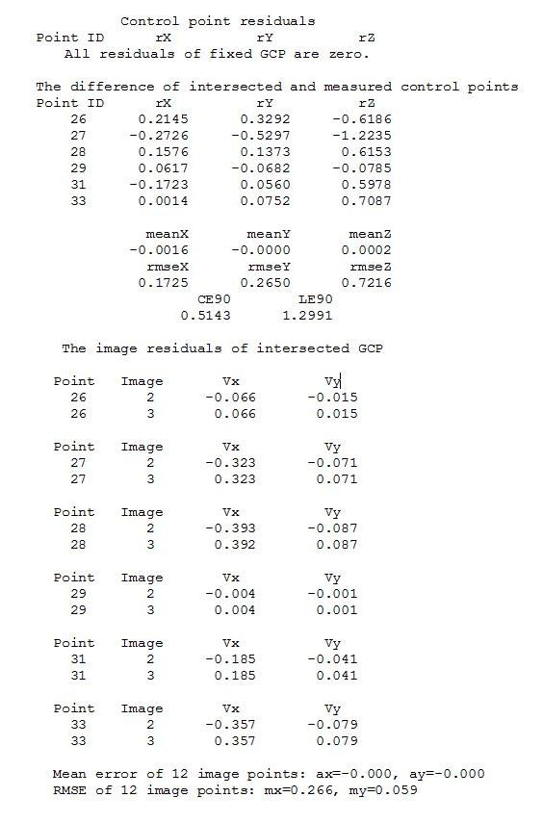
ACCURACY REPORT
GCP points
S. No. | Latitude | Longitude | Elevation ( EGM96)
26 | 28°32'43.93"N | 77°09'34.85"E | 248.809
27 | 28°32'53.18"N | 77°08'00.23"E | 249.08
28 | 28°32'20.08"N | 77°09'17.34"E | 257.911
29 | 28°31'33.98"N | 77°06'05.97"E | 237.846
30 | 28°32'05.52"N | 77°06'31.64"E | 238.121
31 | 28°30'44.67"N | 77°07'58.17"E | 273.945
Observation
The RMSE error 0.7216m is less than 1 m with acceptable limits
Plate 8

Slide 10
Comparison between LIDAR and Satellite Photogrammetry Technologies
 | Satellite Photogrammetry | LIDAR
Data acquisition | Done via satellite by companies like Digital Globe, Airbus, ISRO. | Requires specialized and expensive equipment.
Cost | Affordable Runs in lacs for 100 sq. km | Expensive flight operation and equipment costs. Runs in Crores for 100 sq. km
Repeatability | Data can be updated as frequently as 1 week. | Prohibitively expensive to update data due to advanced flight permission and planning involved.
Accuracy | Better than 100cm | Better than 10cm
Manpower skill and software | Well developed software and workflows and enough skilled manpower available | Specialized software and skilled manpower is scarce.
Photorealistic modelling | High resolution modeling true color imaging possible | Not possible
Plate 9

Slide 11
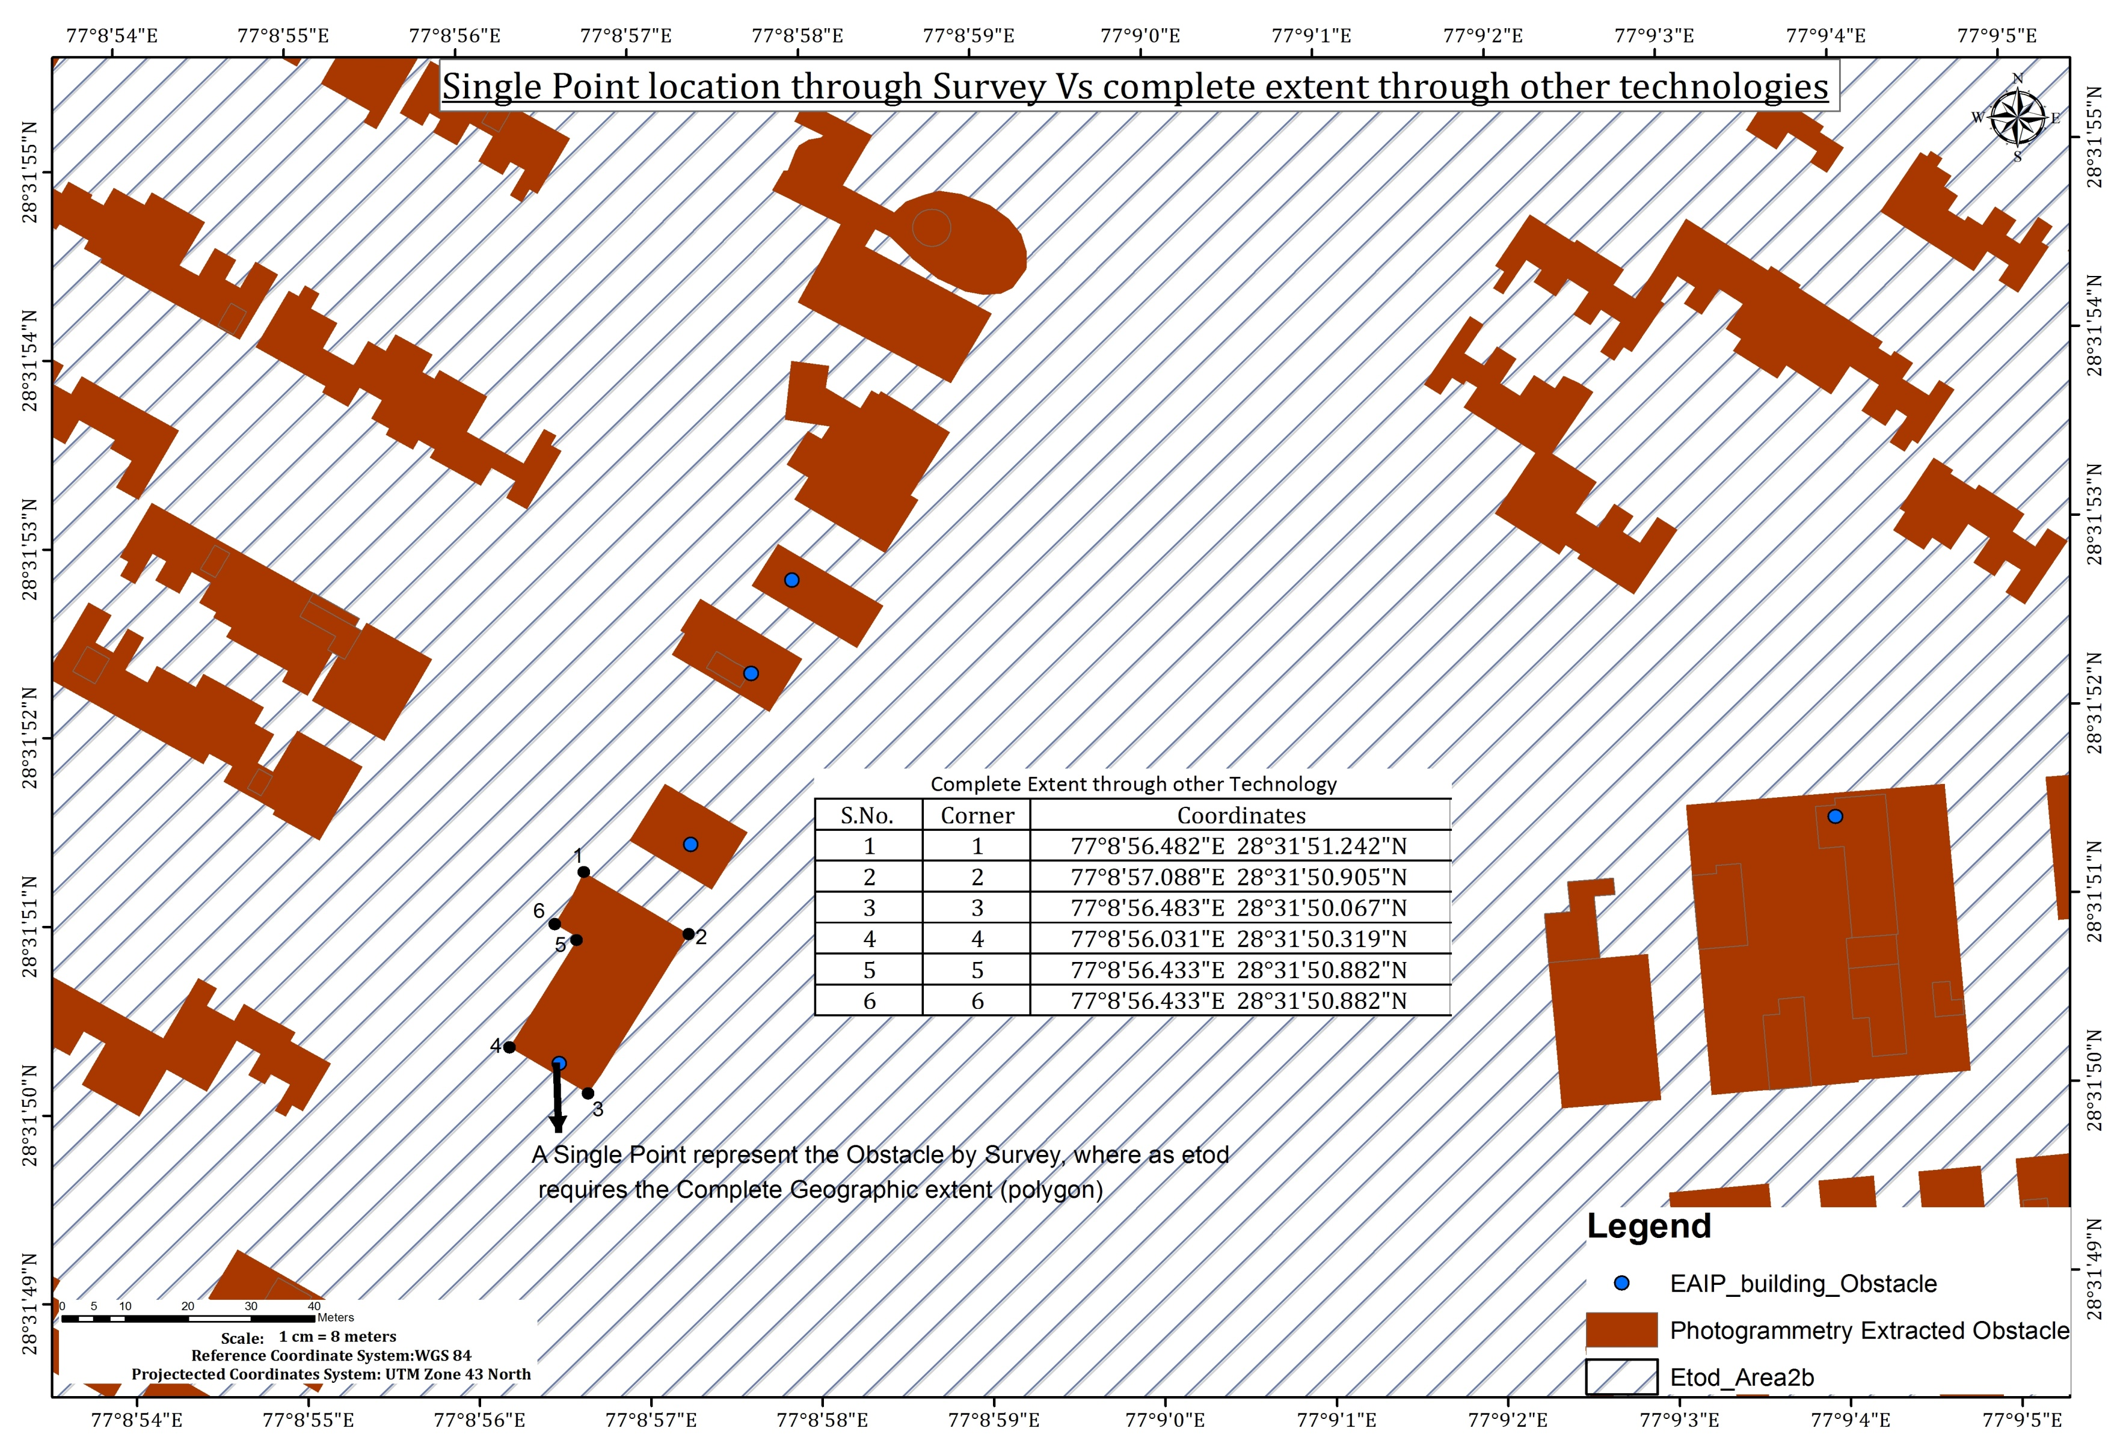

Slide 12
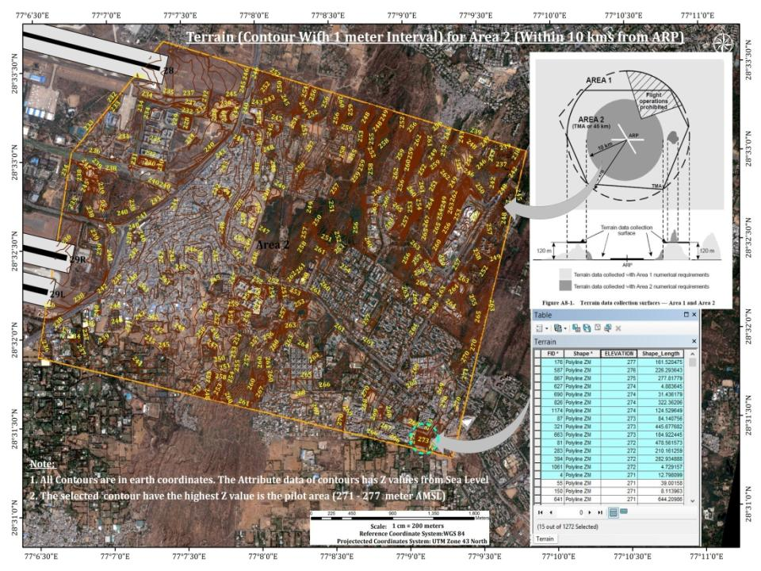
Plate 10

Slide 13
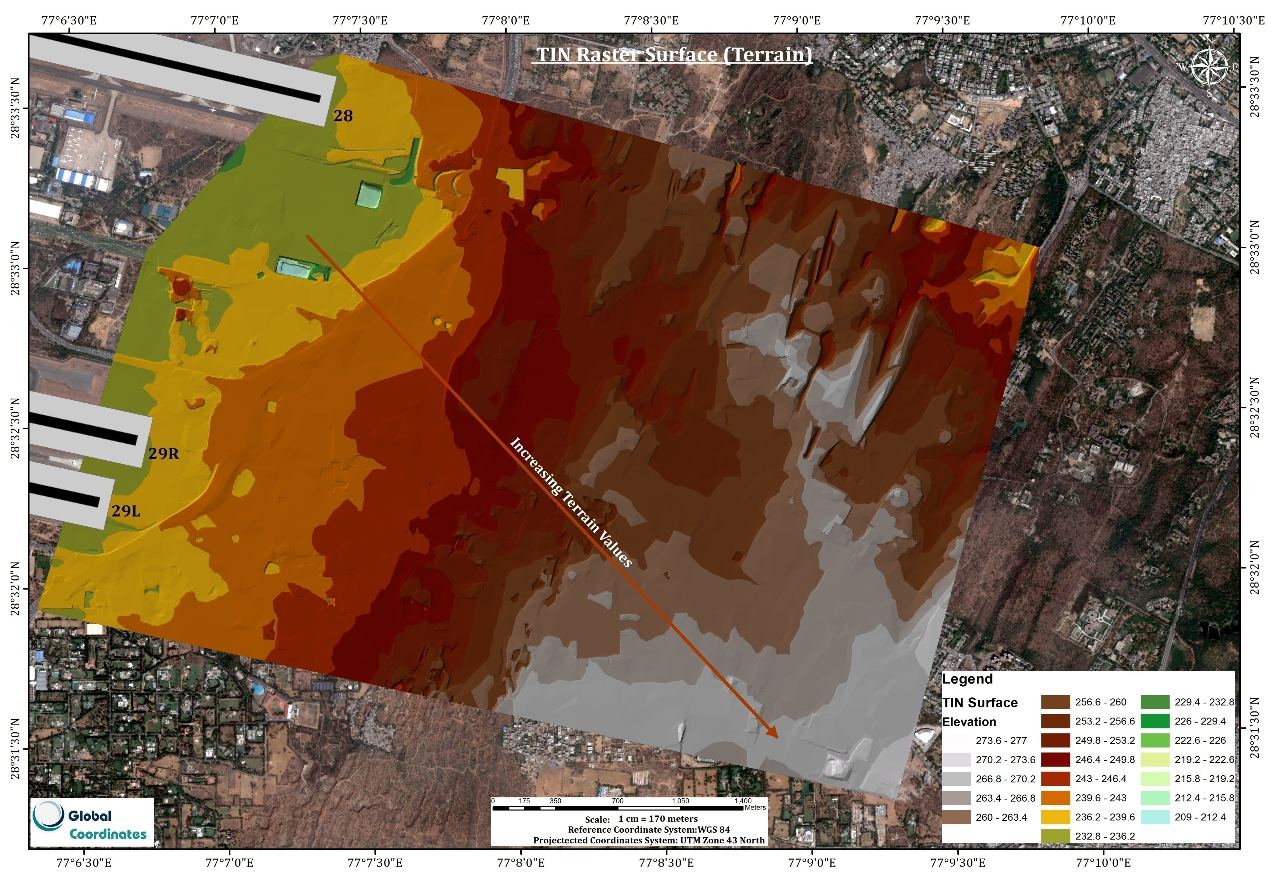
Plate 11

Slide 14
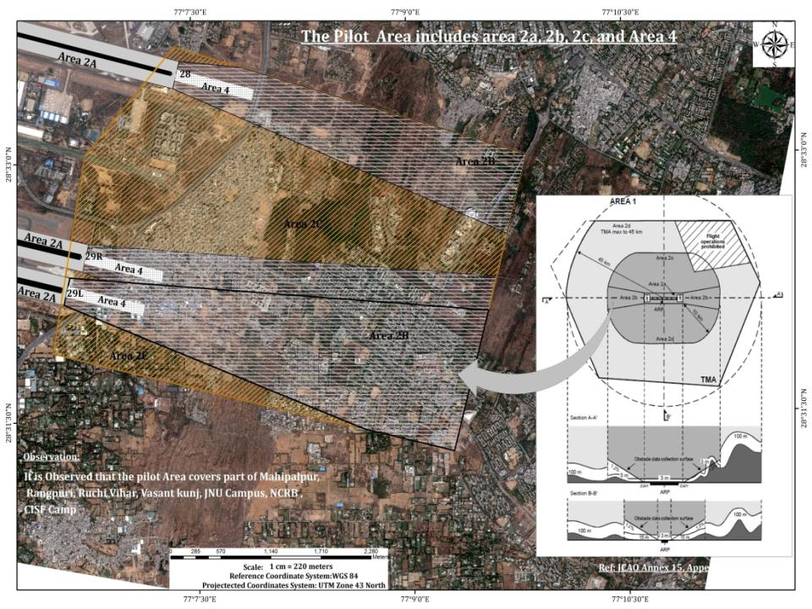
Plate 12

Slide 15
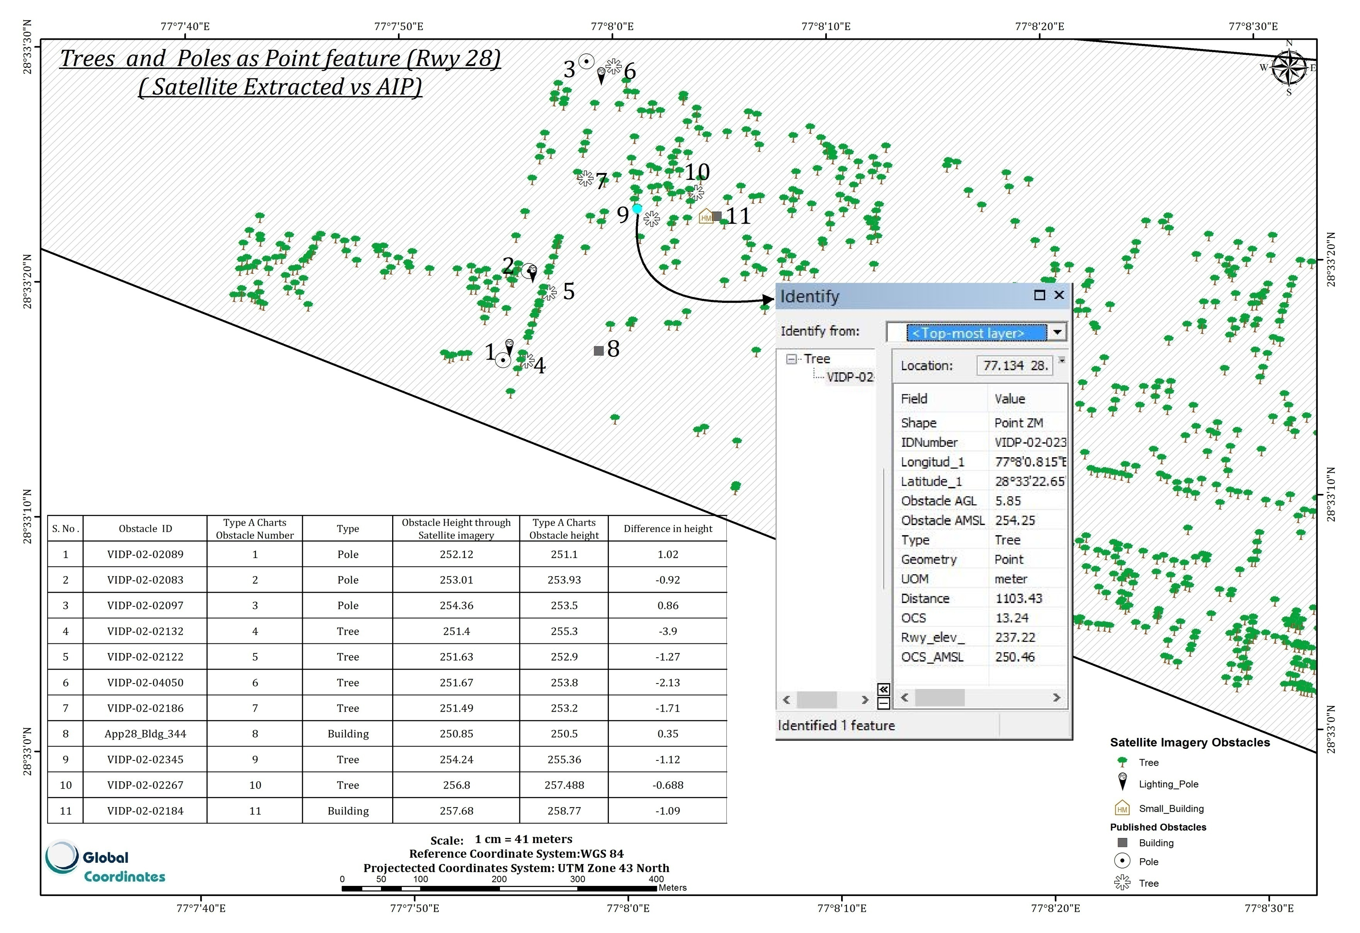
Plate 13

Slide 16
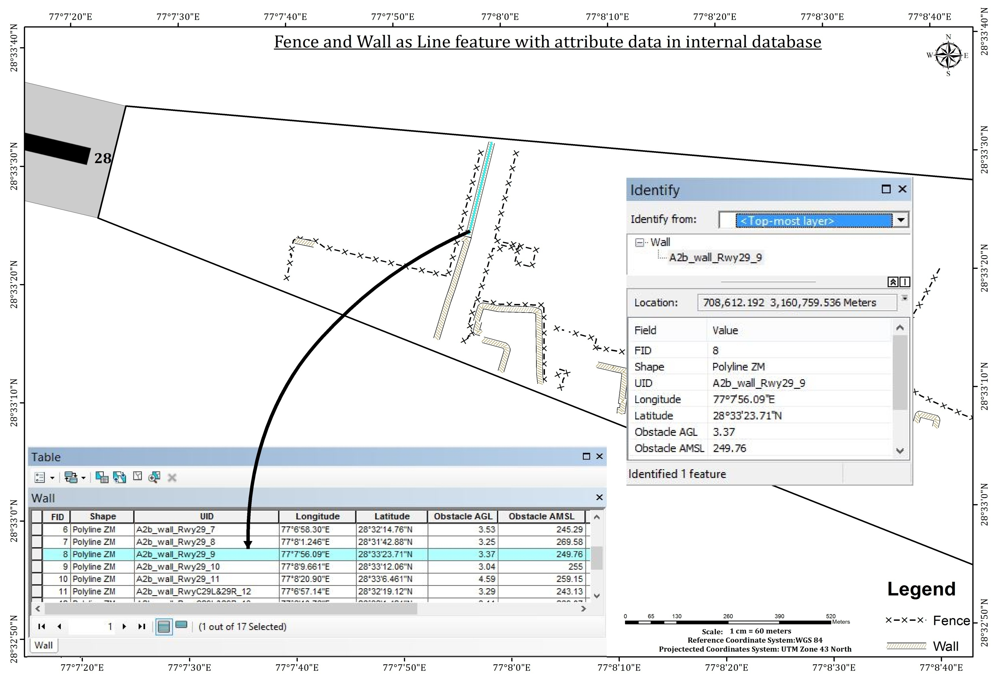
Plate 14

Slide 17
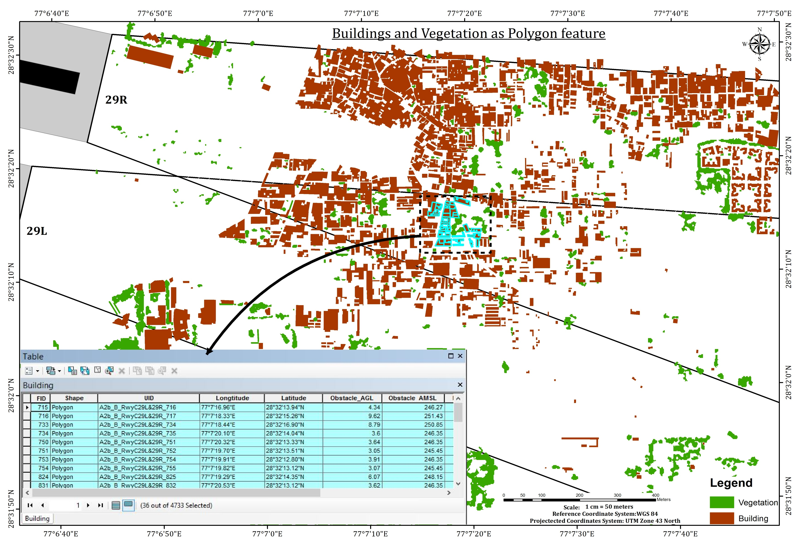
Plate 15

Slide 18
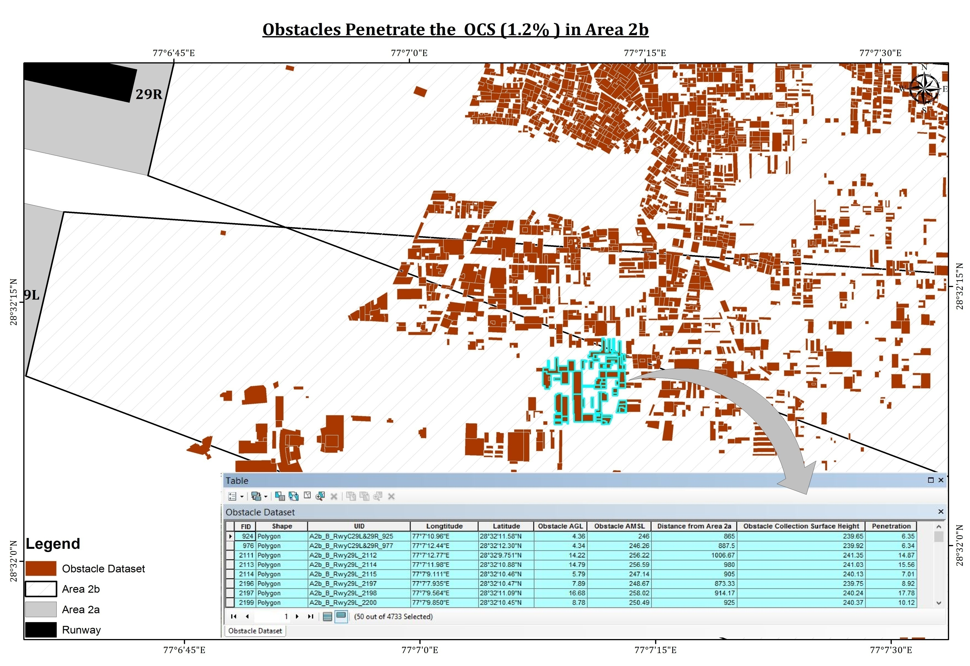
Obstacles Penetrating the OCS (1.2%) in Area 2b
Plate 16

Slide 19
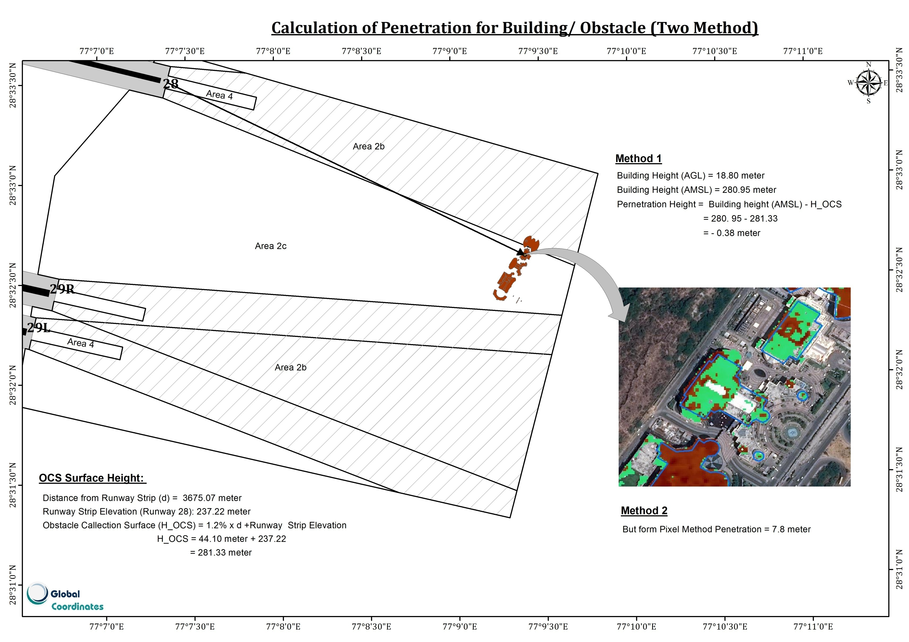

Slide 20
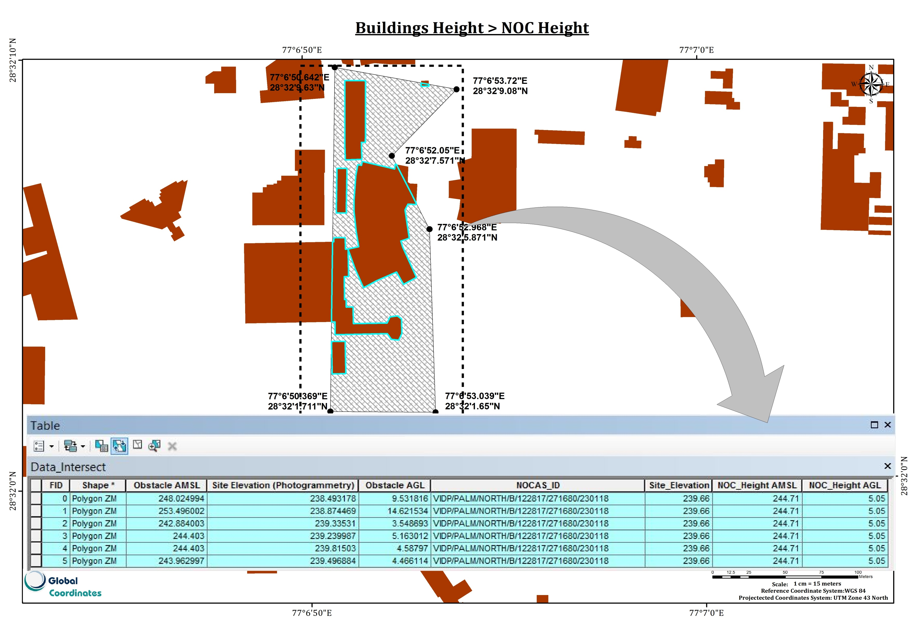
Plate 19

Slide 21
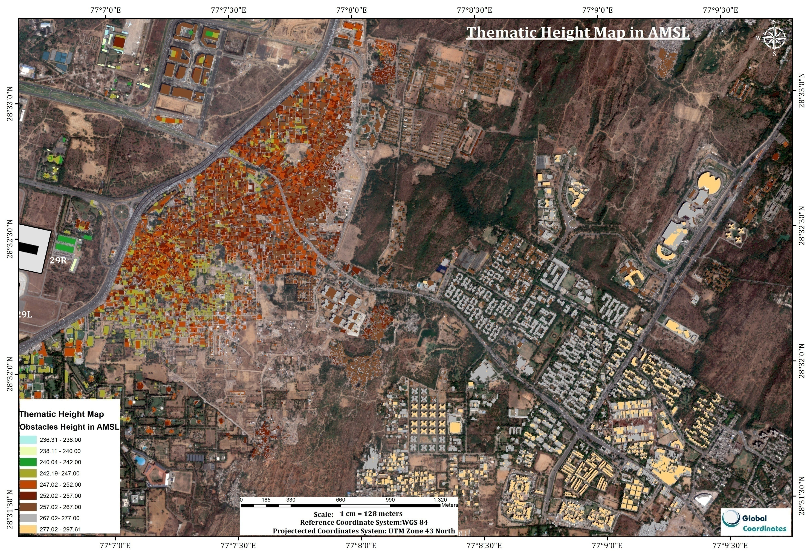
Plate 17

Slide 22
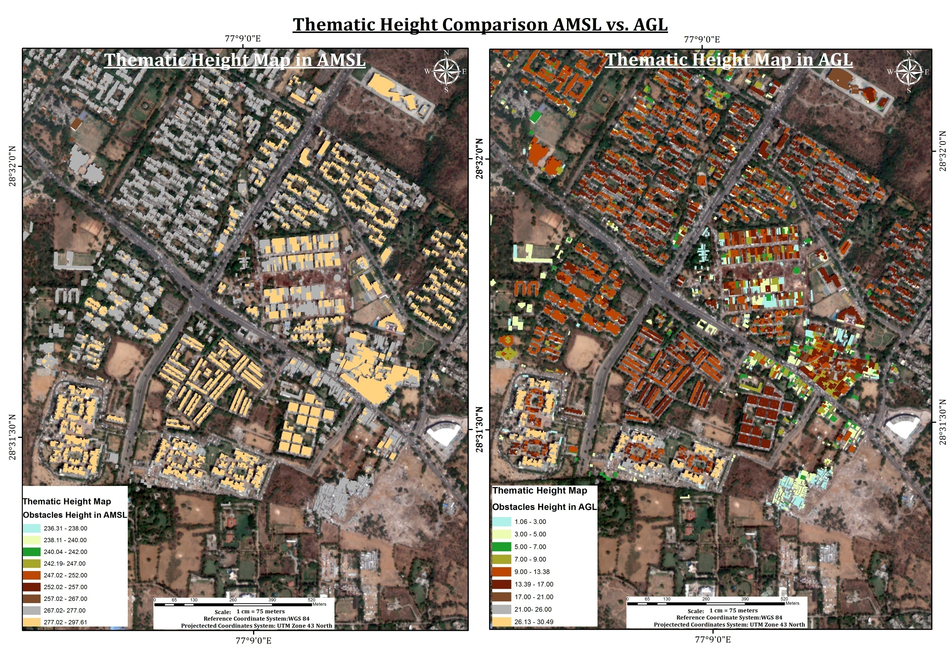
Plate 18

Slide 23
Validation of obstacle height (AMSL, meter) extracted through photogrammetry with field Survey
Point_ID | Longitude | Latitude | Description | A= DGPS Height | B =Photogrammetry Extracted Height | Difference ( A - B)
5 | 77°08'58.85"E | 28°31'45.00"N | Top of building with Superstructure | 273.01 | 273.32 | -0.305
7 | 77°08'56.42"E | 28°31'46.02"N | Top of building | 279.11 | 278.75 | 0.360
12 | 77°08'56.96"E | 28°31'51.49"N | Top of building | 277.47 | 276.95 | 0.519
13 | 77°08'56.97"E | 28°31'51.94"N | Top of building | 271.05 | 270.57 | 0.479
14 | 77°08'57.12"E | 28°31'51.79"N | Top of building with Superstructure | 274.58 | 273.22 | 1.357*
15 | 77°08'57.73"E | 28°31'52.32"N | Top of building | 278.65 | 278.75 | -0.104
18 | 77°08'58.09"E | 28°31'52.52"N | Top of building | 278.59 | 277.85 | 0.735
20 | 77°09'06.08"E | 28°32'07.09"N | Top of building | 278.84 | 278.75 | 0.087
22 | 77°09'06.92"E | 28°32'06.65"N | Top of building with Superstructure | 281.86 | 280.85 | 1.014
24 | 77°08'30.32"E | 28°31'37.33"N | Top of building | 284.41 | 284.37 | 0.039
27 | 77°08'27.31"E | 28°31'34.87"N | Top of building | 283.52 | 283.38 | 0.139
28 | 77°08'27.31"E | 28°31'34.87"N | Top of building with Superstructure | 285.38 | 285.88 | -0.502
30 | 77°08'09.98"E | 28°31'38.34"N | Top of building | 279.28 | 279.38 | -0.100
31 | 77°08'09.96"E | 28°31'38.55"N | Top of building with Superstructure | 282.39 | 281.76 | 0.630
34 | 77°08'11.12"E | 28°31'38.65"N | Top of building | 282.72 | 282.51 | 0.212
Calculated vertical accuracy report based on Top elevation:
Root Mean Square Error (RMSE):
Z- Value absolute RMSE = √((-0.305)² + (0.360)²+ (0.305)²+ (-0.519)²+ (0.479)²+ (1.357)² + (-0.104)²+ (0.735)²+ (0.087)²+ (1.014)²+ (0.039)²+ (0.139)² + (-0.502)²+ (-0.100)²+ (0.630)² + (0.212)²)/15
= √(0.32376 )/15
= +/- 0.569 m < 1 m
It is Observed that absolute RMSE < 1 m, Which is acceptable as per accuracy certain define for Area 2.
*Maximum difference of absolute Z- Value: 1.35 m but this is an aberration and needs to be checked again.
Plate 20

