Slide 1


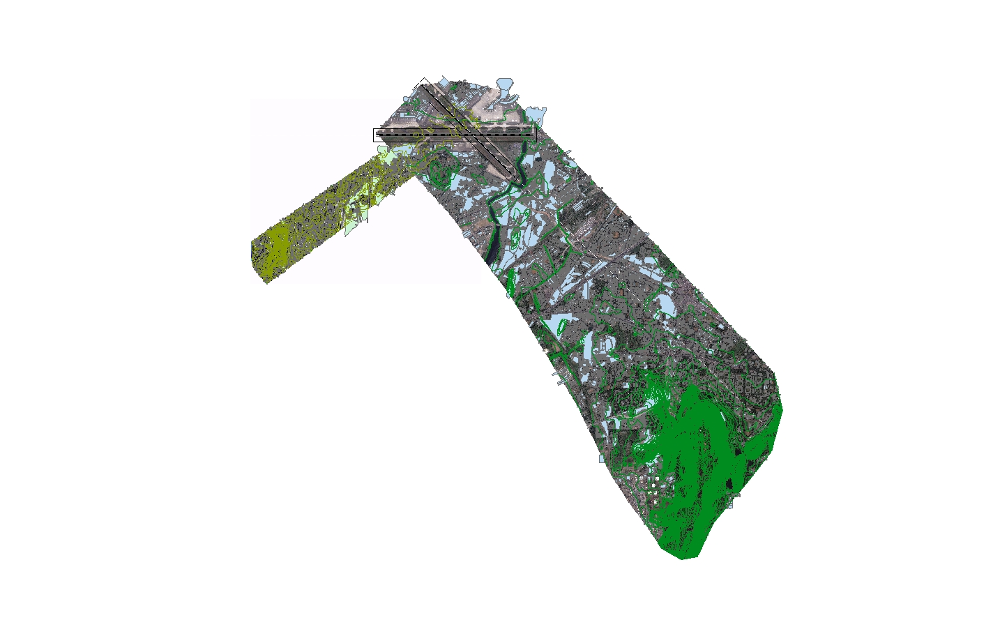
“Like failure, chaos contains information that can lead to knowledge -- even wisdom. Like art.“ Toni Morrison
TOD ( Santa Cruz )
by M/s Global Coordinates

Slide 2
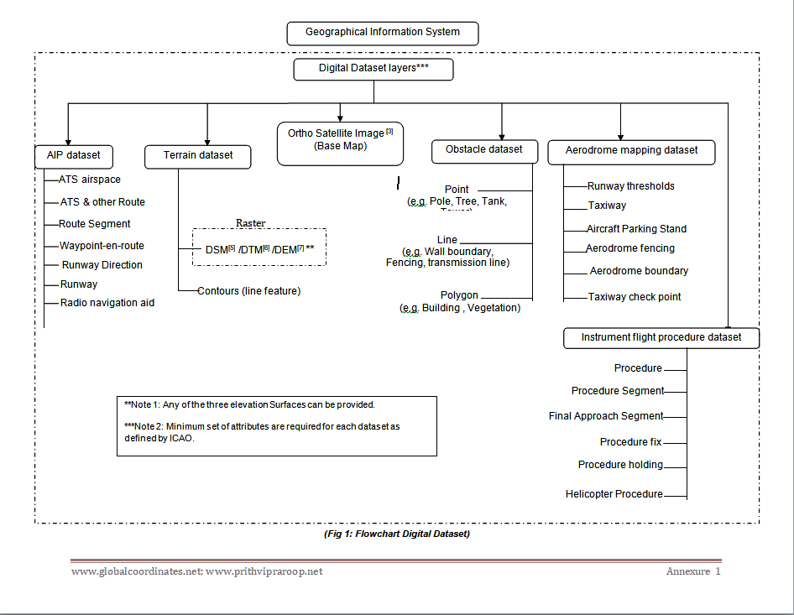

Slide 3
TOD Santa Cruz has been created through data mining from all the revised NOC’s issued for enhanced height through Aeronautical Studies for Santa Cruz and Juhu Aerodrome in the years 2018,2019, 2020, 2021 as well as the obstacles published in the AIP. Since an Aeronautical Study is only carried out when a proposed structure penetrates the OLS, all such structures/buildings qualify for being part of the obstacle database as stated in Sec 5.3.3.4.5, CAR Series I Part I.
All the NOC’s for which enhanced height has been granted through the process of Appeal and Aeronautical Studies as published in the MOM of the Appeal Committee as well as the AIP have been collected and plotted in a GIS environment. The digital data thus created has been overlaid on Cartosat-3 Mx geo-referenced satellite imagery with a resolution of 1.12m. All visible building footprints have also been captured. The distance of the nearest coordinate of each NOC polygon / Obstacle listed in the AIP has been calculated from the Runway end as well as Runway strip to calculate the penetration of the OLS surface and the TOD Obstacle collection surface. All this data has been tabulated and linked to the NOC polygons / Obstacles published in the AIP. This meets the requirement of TOD as required by CAR Series I Part I.
The layers of digital data created as per TOD requirements are as follows:
Santa Cruz Aerodrome dataset
Juhu Aerodrome dataset
Cartosat-3 Mx geo-referenced satellite imagery with a resolution of 1.12m covering the OLS surfaces + Area 2c
AIP TOD dataset
Appeal TOD dataset

Slide 4
Need for digital datasets of terrain and obstacles
A key driver for the transition from AIS to AIM is the need to achieve an uninterrupted aeronautical data chain with no loss or corruption in information, in a pre-defined format and with guaranteed accuracy and integrity. The aeronautical data chain is defined as “a series of interrelated links wherein each link provides a function that facilitates the origination, transmission and use of aeronautical data for a specific purpose”.

Slide 5
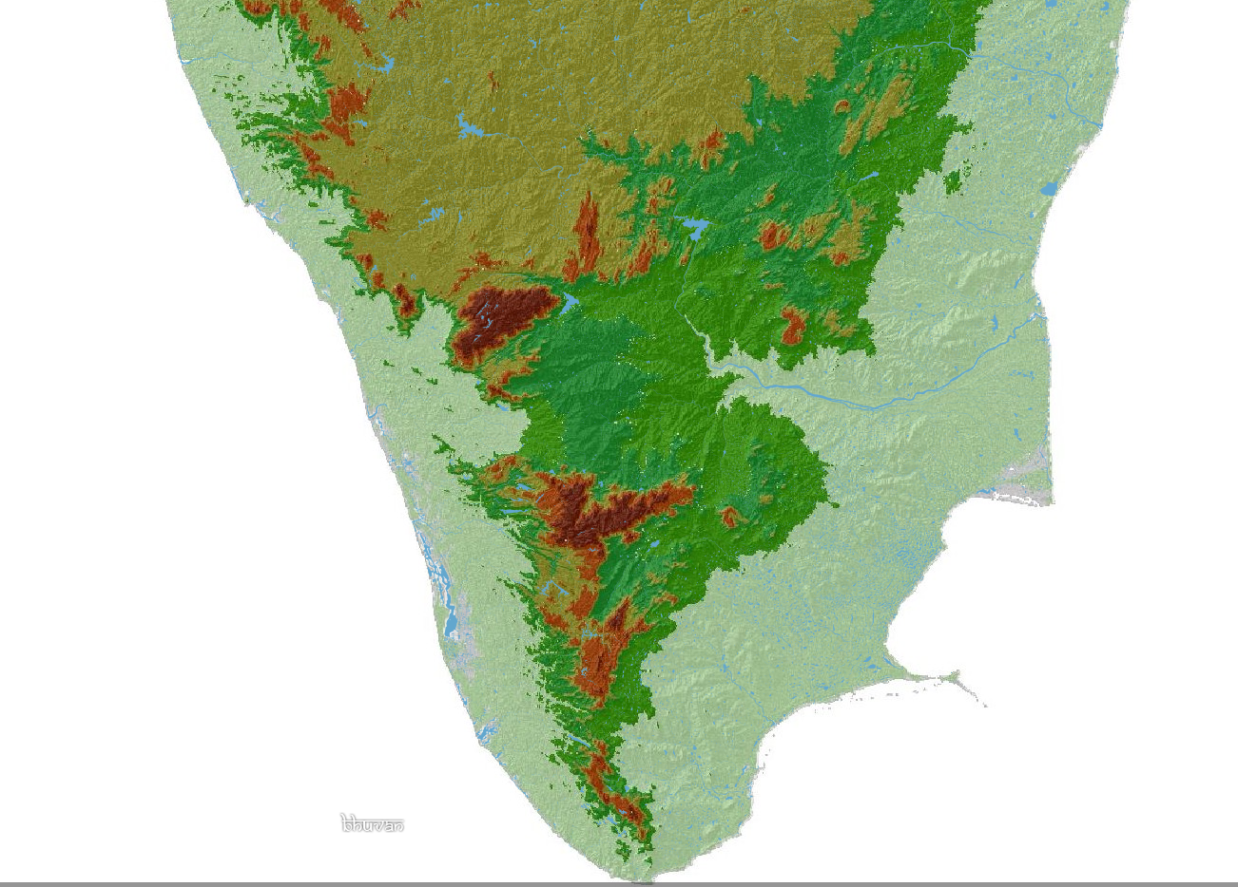
TERRAIN DATA
CIVIL AVIATION REQUIREMENTS SERIES I PART I SECTION 9 , 8th JANUARY 2010 , Rev. 6, 20th September 2021
5.3.3.3 Terrain Data Sets
5.3.3.3.1 Terrain data sets shall contain the digital representation of the terrain surface in the form of continuous elevation values at all intersections (points) of a defined grid, referenced to common datum.
Source: https://bhuvan.nrsc.gov.in/

Slide 6
Terrain data: Shall/Mandatory CIVIL AVIATION REQUIREMENTS SERIES I PART I SECTION 9 , 8th JANUARY 2010 , Rev. 6, 20th September 2021
Sec 5.3.3.2: For aerodromes regularly used by international civil aviation, terrain data shall be provided
for :
Area 1
Area 2a
Take-off flight path Area
An area bounded by the lateral extents of the aerodrome obstacle limitation surfaces.
Sec 5.3.3.3.7: For aerodromes regularly used by international civil aviation, terrain data shall be provided for Area 4, for all runways where precision approach category II or III operations have been established and where detailed terrain information is required by operators to enable them to assess the effect of terrain on decision height determination by use of radio altimeters.
[Sets of electronic terrain data shall include spatial ( position and elevation), thematic and temporal aspects for the surface of the Earth containing naturally occurring features such as mountains, hills, ridges, valleys, bodies of water, permanent ice and snow, excluding obstacles. This shall represent the continuous surface that exists at the bare earth, the top of the canopy or something in between, also known as the ‘first reflective surface’.]
Terrain features attributes: Table A 6-1

Slide 7
TERRAIN ATTRIBUTES
Appendix 6
Table A6-1. Terrain attributes
Terrain attribute |  |  | Mandatory/Optional
Area of coverage |  |  | Mandatory
Data originator identifier |  |  | Mandatory
Data source identifier |  |  | Mandatory
Acquisition method |  |  | Mandatory
Post spacing |  |  | Mandatory
Horizontal reference system |  |  | Mandatory
Horizontal resolution |  |  | Mandatory
Horizontal accuracy |  |  | Mandatory
Horizontal confidence level |  |  | Mandatory
Horizontal position |  |  | Mandatory
Elevation |  |  | Mandatory
Elevation reference |  |  | Mandatory
Vertical reference system |  |  | Mandatory
Vertical resolution |  |  | Mandatory
Vertical accuracy |  |  | Mandatory
Vertical confidence level |  |  | Mandatory
Surface type |  |  | Optional
Recorded surface |  |  | Mandatory
Penetration level |  |  | Optional
Known variations |  |  | Optional
Integrity |  |  | Mandatory
Date and time stamp |  |  | Mandatory
Unit of measurement used |  |  | Mandatory

Slide 8
Obstacle data: Shall/Mandatory CIVIL AVIATION REQUIREMENTS SERIES I PART I SECTION 9 , 8th JANUARY 2010 , Rev. 6, 20th September 2021
Sec 5.3.3.4.1: Obstacle data sets shall contain the digital representation of the vertical and horizontal extent of obstacles.
[ PANS AIM Doc 10066 5.3.3.2.2.1 Obstacle data elements are features that shall be represented in the data sets by points, lines or polygons]
Sec 5.3.3.4.3: The obstacle data shall be provided for obstacles in Area 1 whose height is 100m or higher above ground.
Sec 5.3.3.4.4: For aerodromes regularly used by international civil aviation, obstacle data shall be provided for all obstacles within Area 2 that are assessed as being a hazard to air navigation.
Sec 5.3.3.4.5: For aerodromes regularly used by international civil aviation, obstacle data shall be provided for:
a) Area 2a: for those obstacles that penetrate an obstacle data collection surface outlined by a rectangular area around a runway that comprises the runway strip plus any clearway that exists. The Area 2a obstacle collection surface shall have height of 3 m above the nearest runway elevation measured along the runway centre line, and for those portions related to a clearway, if one exists, at the elevation of nearest runway end;
b) Objects in the take-off flight path area which project above a plane surface having a 1.2 per cent slope and having a common origin with the take-off flight path area; and
c) penetrations of the aerodrome obstacle limitation surfaces.
[Note.— Take-off flight path area are specified in Annex 4, 3.8.2. Aerodrome obstacle limitation surfaces are specified in Annex 14, Volume 1, Chapter 4. ]
Sec 5.3.3.4.10 f or Aerodromes regularly used by international civil aviation, obstacle data shall be provided for Area 4, for all runways where precision approach Category II or III operations have been established.
.
Obstacle features attributes: Table A 6-2

Slide 9
OBSTACLE ATTRIBUTES
Appendix 6
Table A6-2. Obstacle attributes
Obstacle attribute |  |  | Mandatory/Optional
Area of coverage |  |  | Mandatory
Data originator identifier |  |  | Mandatory
Data source identifier |  |  | Mandatory
Obstacle identifier |  |  | Mandatory
Horizontal accuracy |  |  | Mandatory
Horizontal confidence level |  |  | Mandatory
Horizontal position |  |  | Mandatory
Horizontal resolution |  |  | Mandatory
Horizontal extent |  |  | Mandatory
Horizontal reference system |  |  | Mandatory
Elevation |  |  | Mandatory
Height |  |  | Optional
Vertical accuracy |  |  | Mandatory
Vertical confidence level |  |  | Mandatory
Vertical resolution |  |  | Mandatory
Vertical reference system |  |  | Mandatory
Obstacle type |  |  | Mandatory
Geometry type |  |  | Mandatory
Integrity |  |  | Mandatory
Date and time stamp |  |  | Mandatory
Unit of measurement used |  |  | Mandatory
Operations |  |  | Optional
Effectivity |  |  | Optional
Lighting |  |  | Mandatory

Slide 10
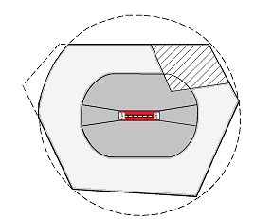
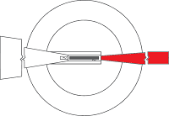

Mandatory areas for TOD: Area 2a, Take off flight path area, Area 4 [ Schematic diagram only ]
Take-off flight path area
Area 4
Area 2a
*Area1 is also mandatory

Slide 11
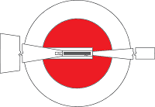
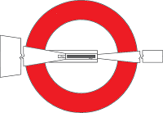
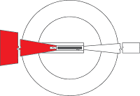

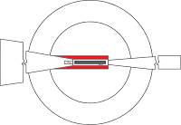


Mandatory areas for TOD: area bounded by the lateral extent of obstacle limitation surfaces [Schematic diagram only ]
IHS
Conical
Approach
Inner Approach
Inner Transitional
Balked landing
Transitional

Slide 12
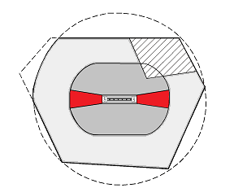
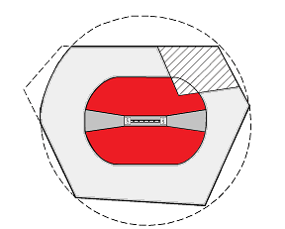
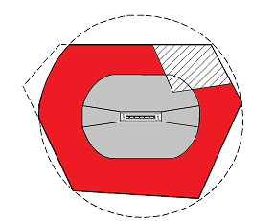

Recommended areas for Obstacle data: Area 2b, 2c, 2d and Area 3
Area 2b
Area 2c
Area 3
Area 2d

Slide 13
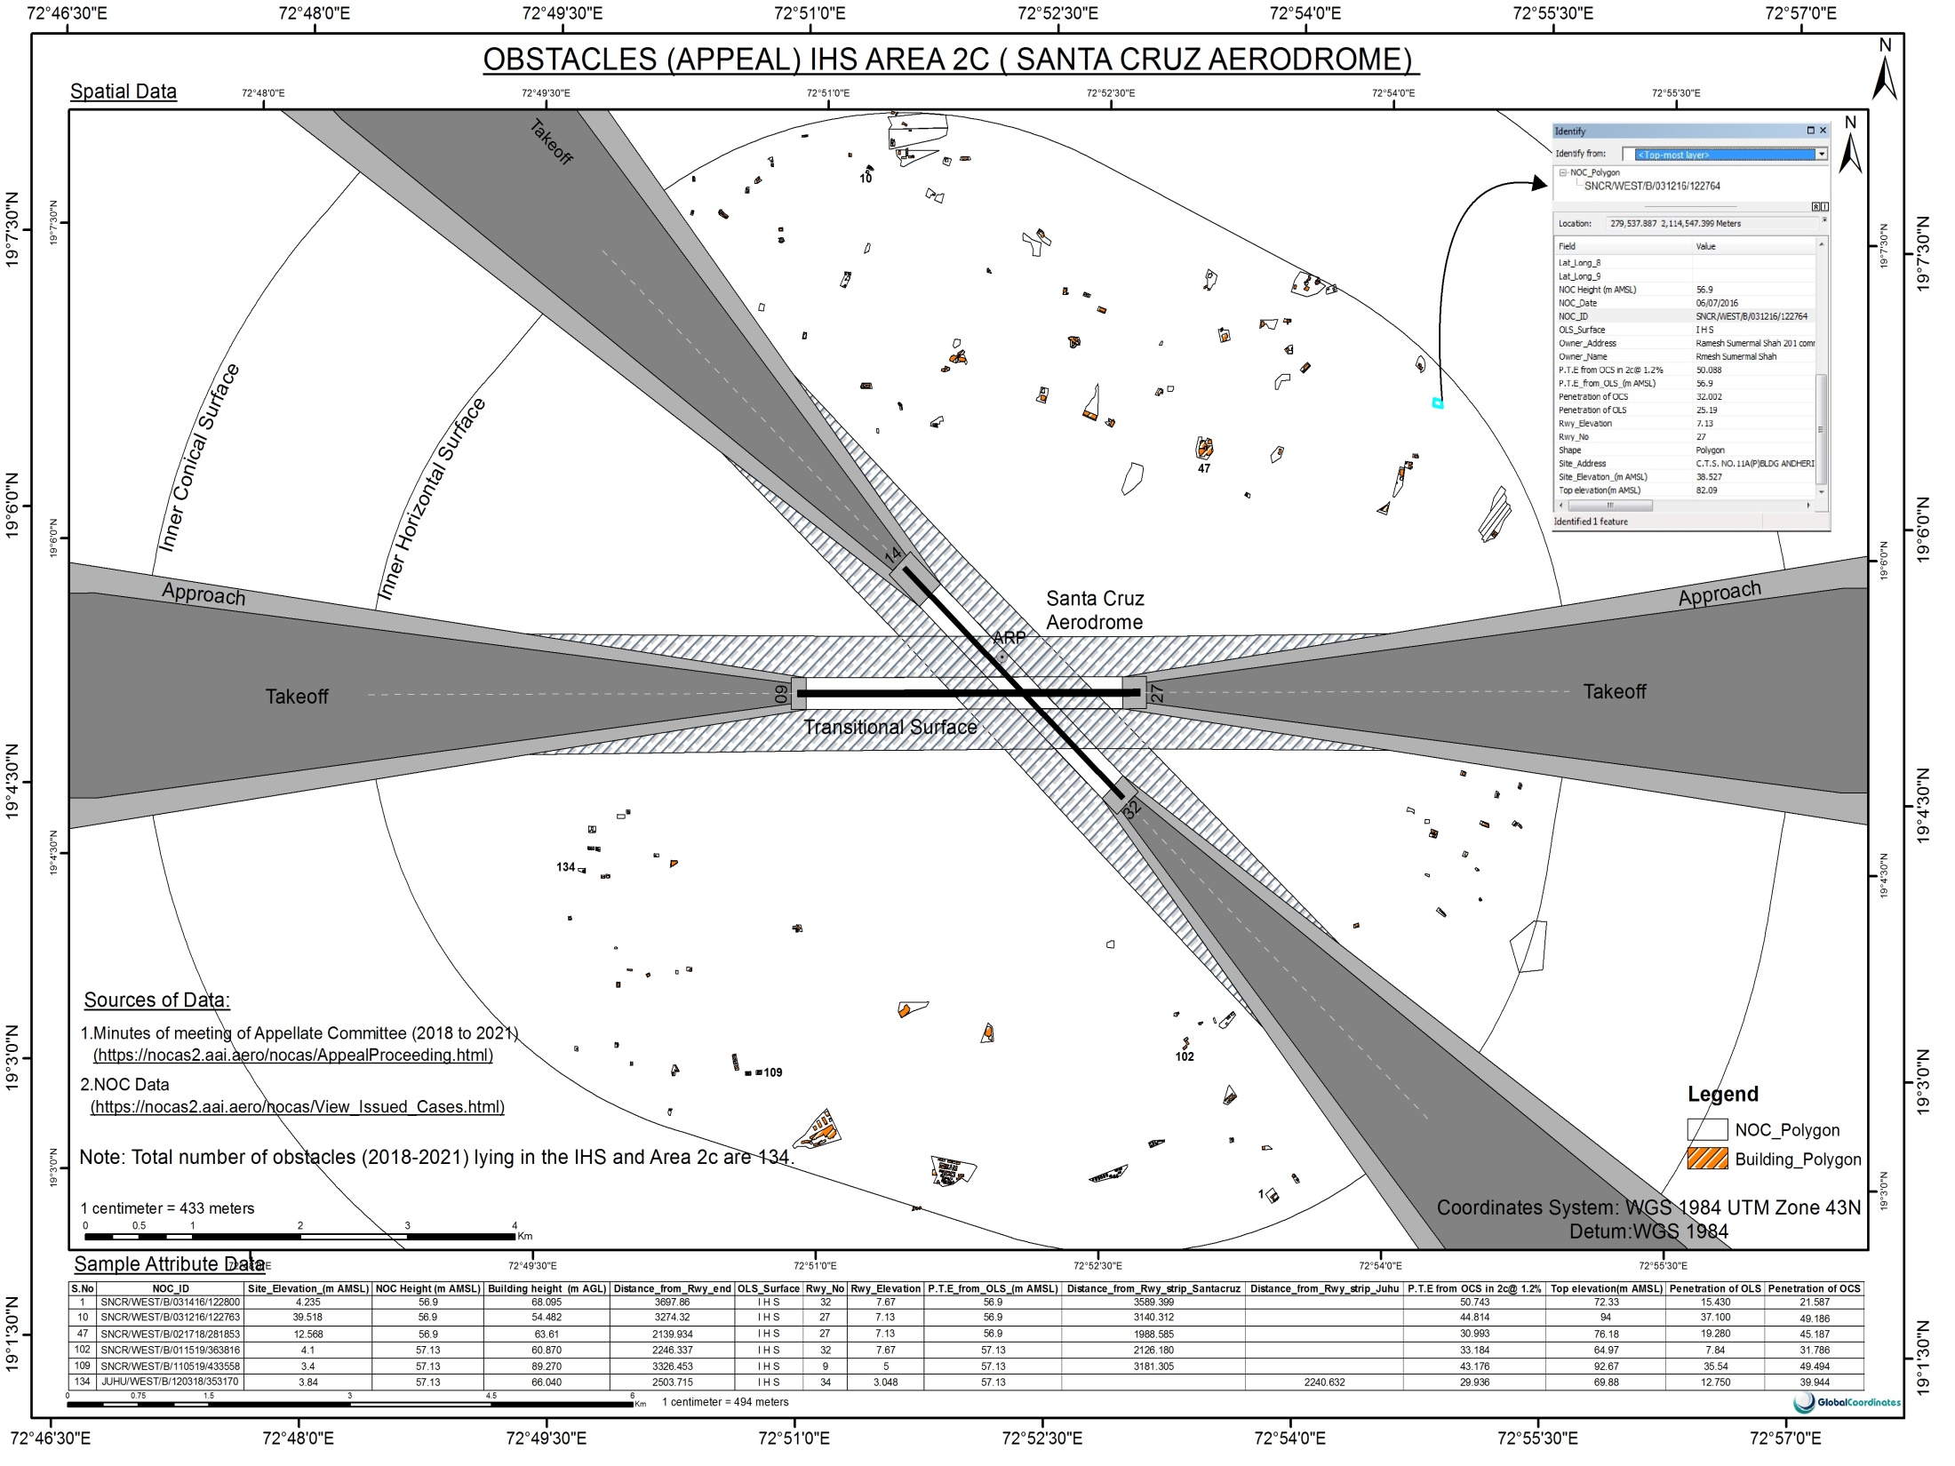

Slide 14
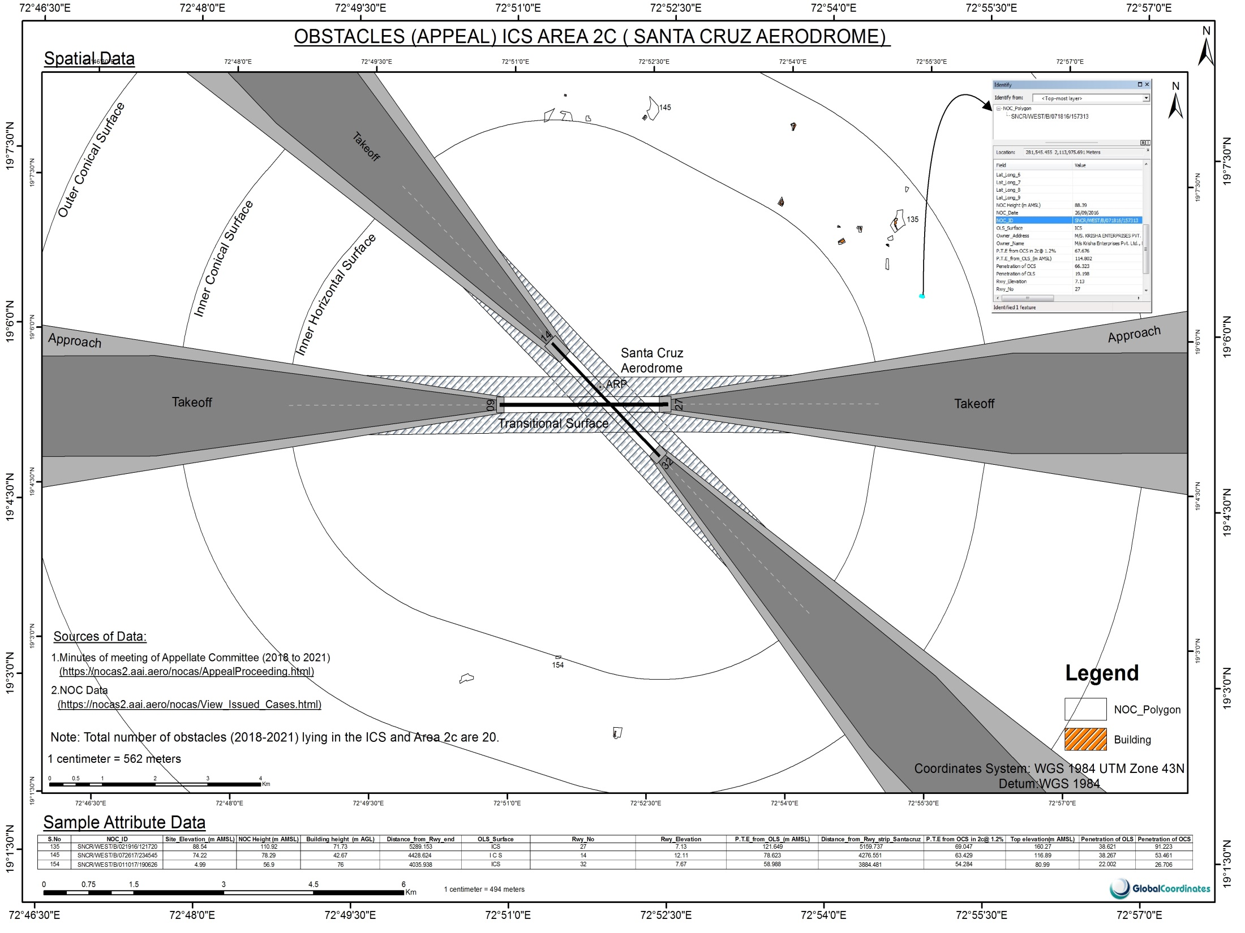

Slide 15
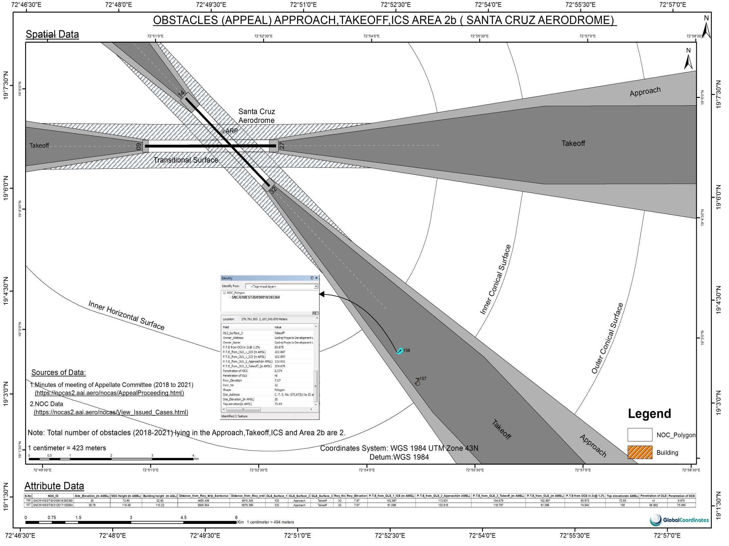

Slide 16
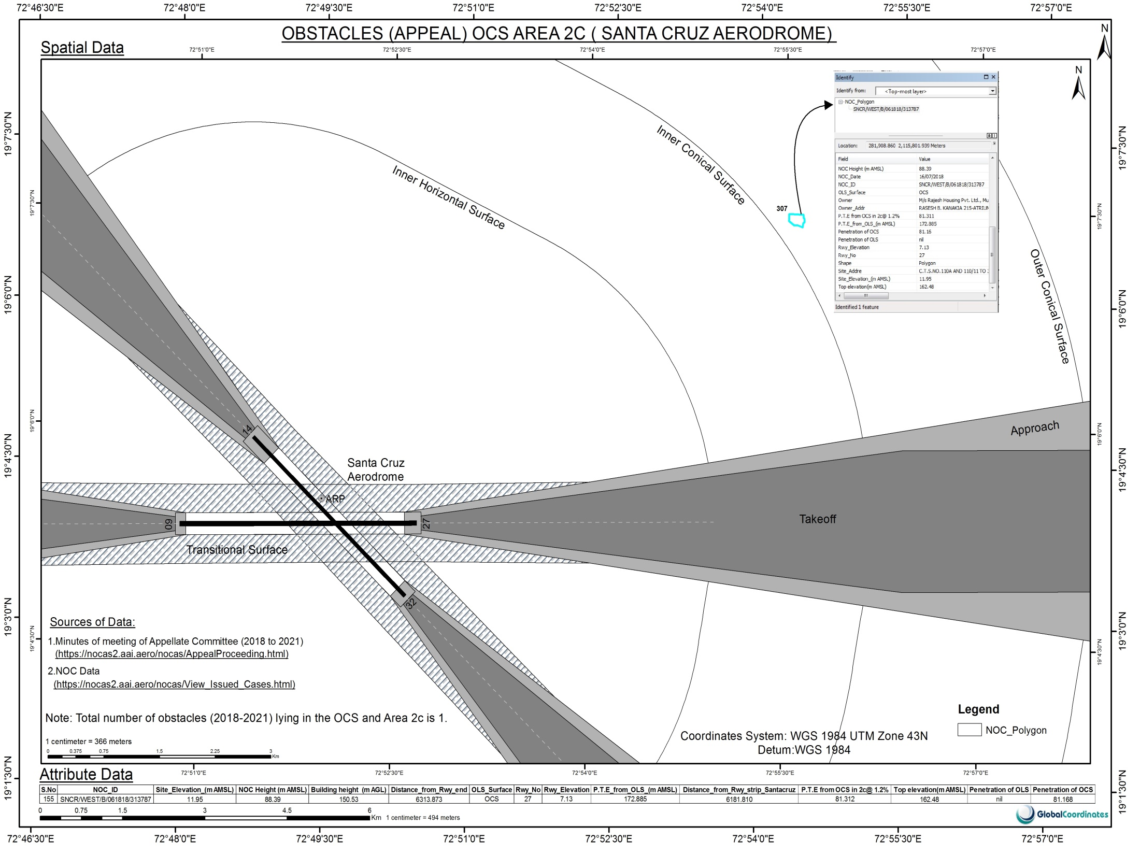

Slide 17
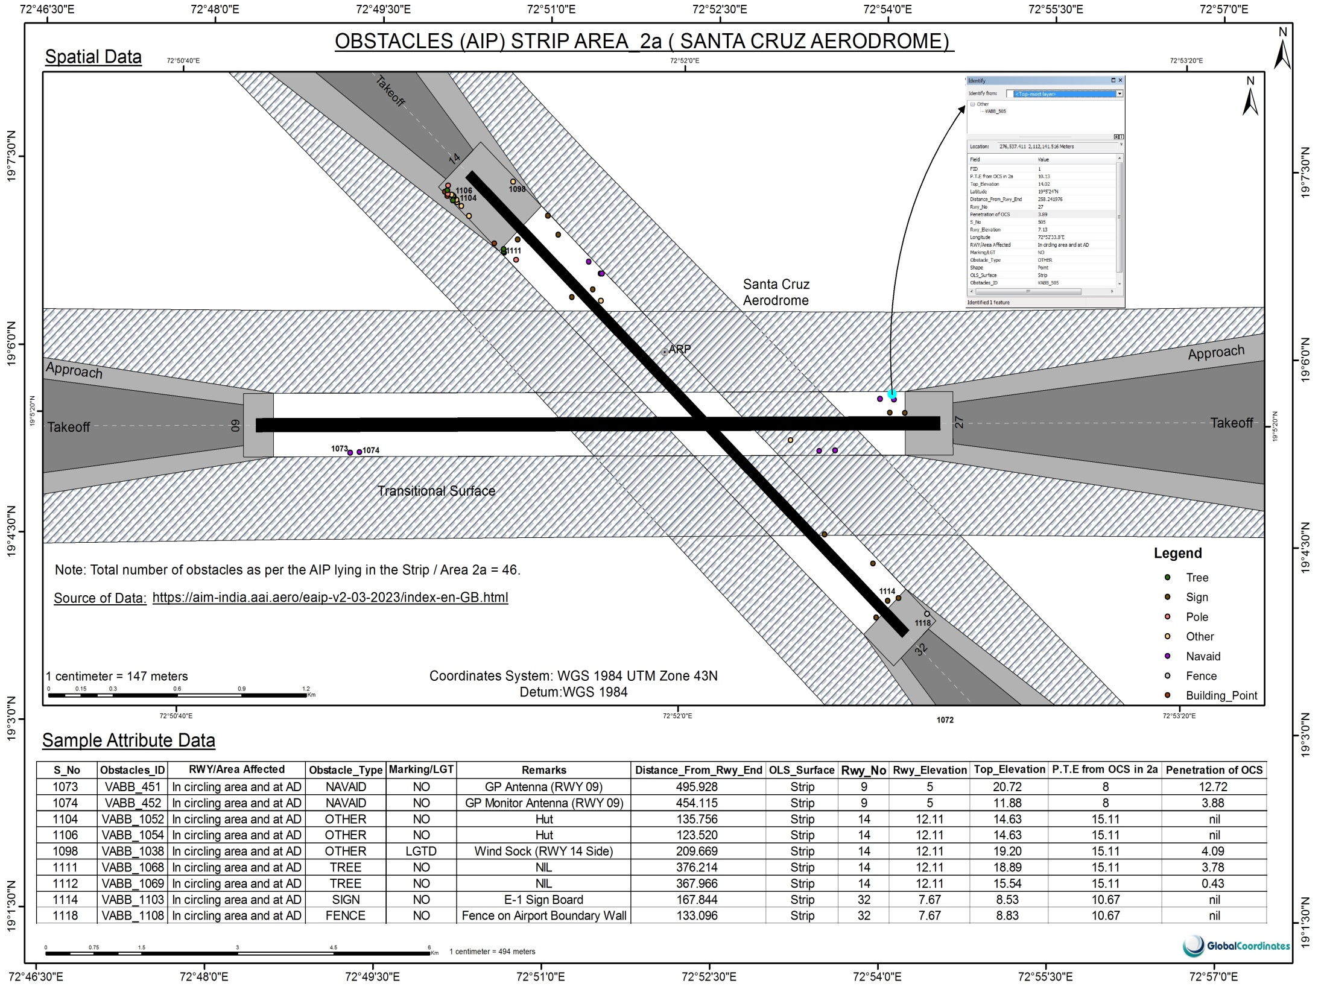

Slide 18
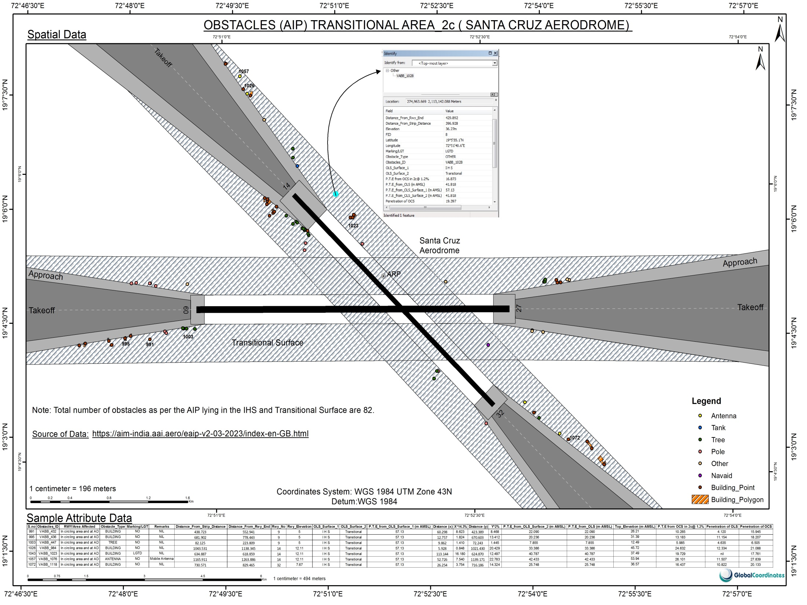

Slide 19
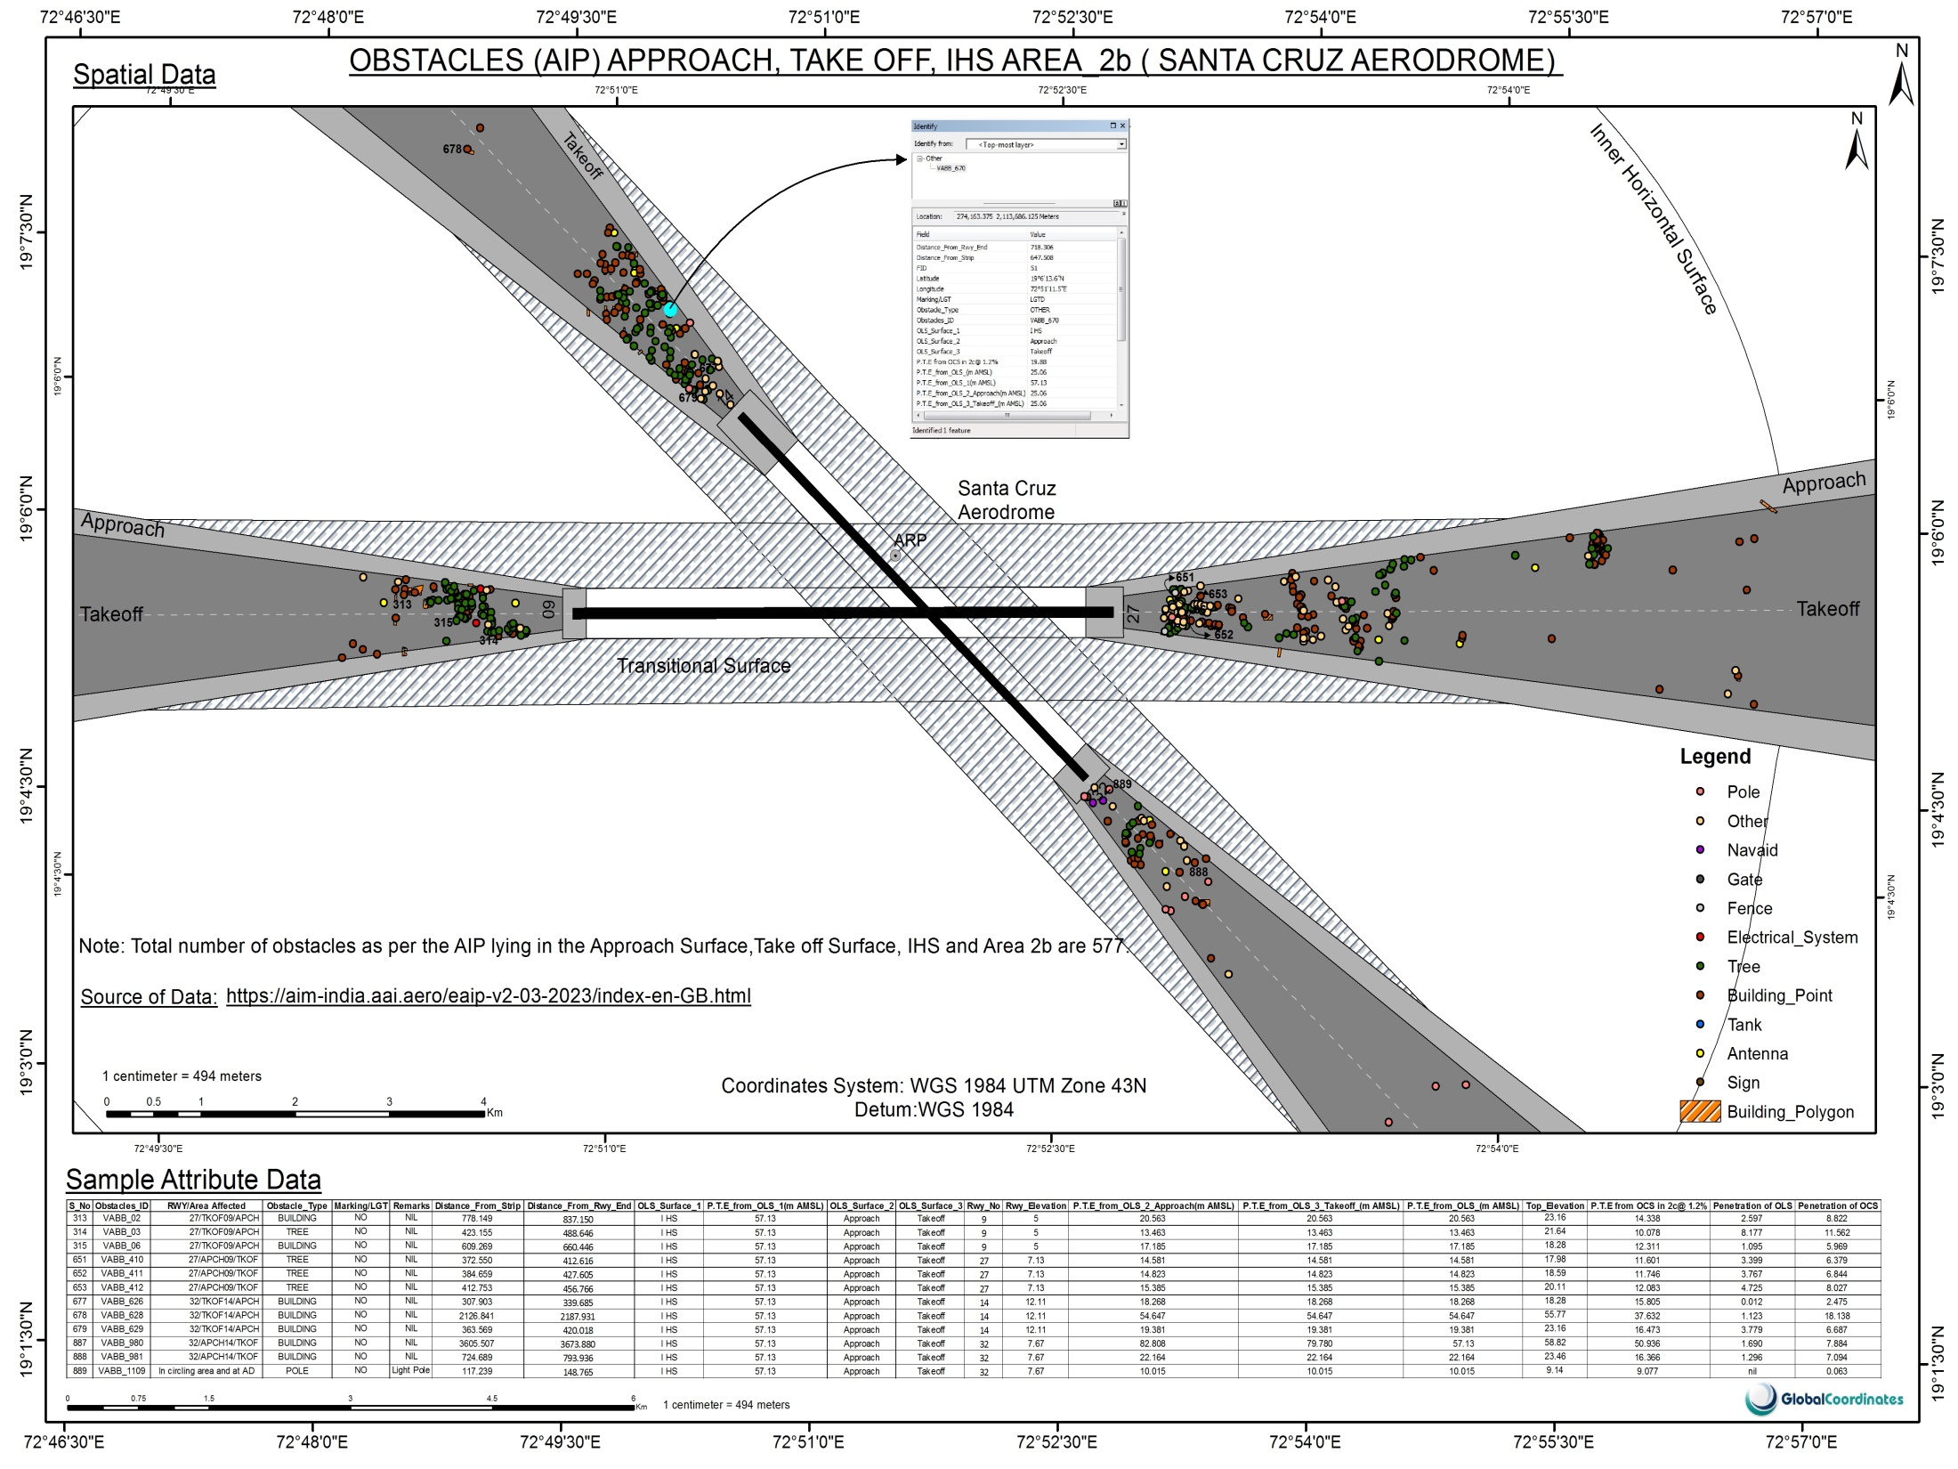

Slide 20
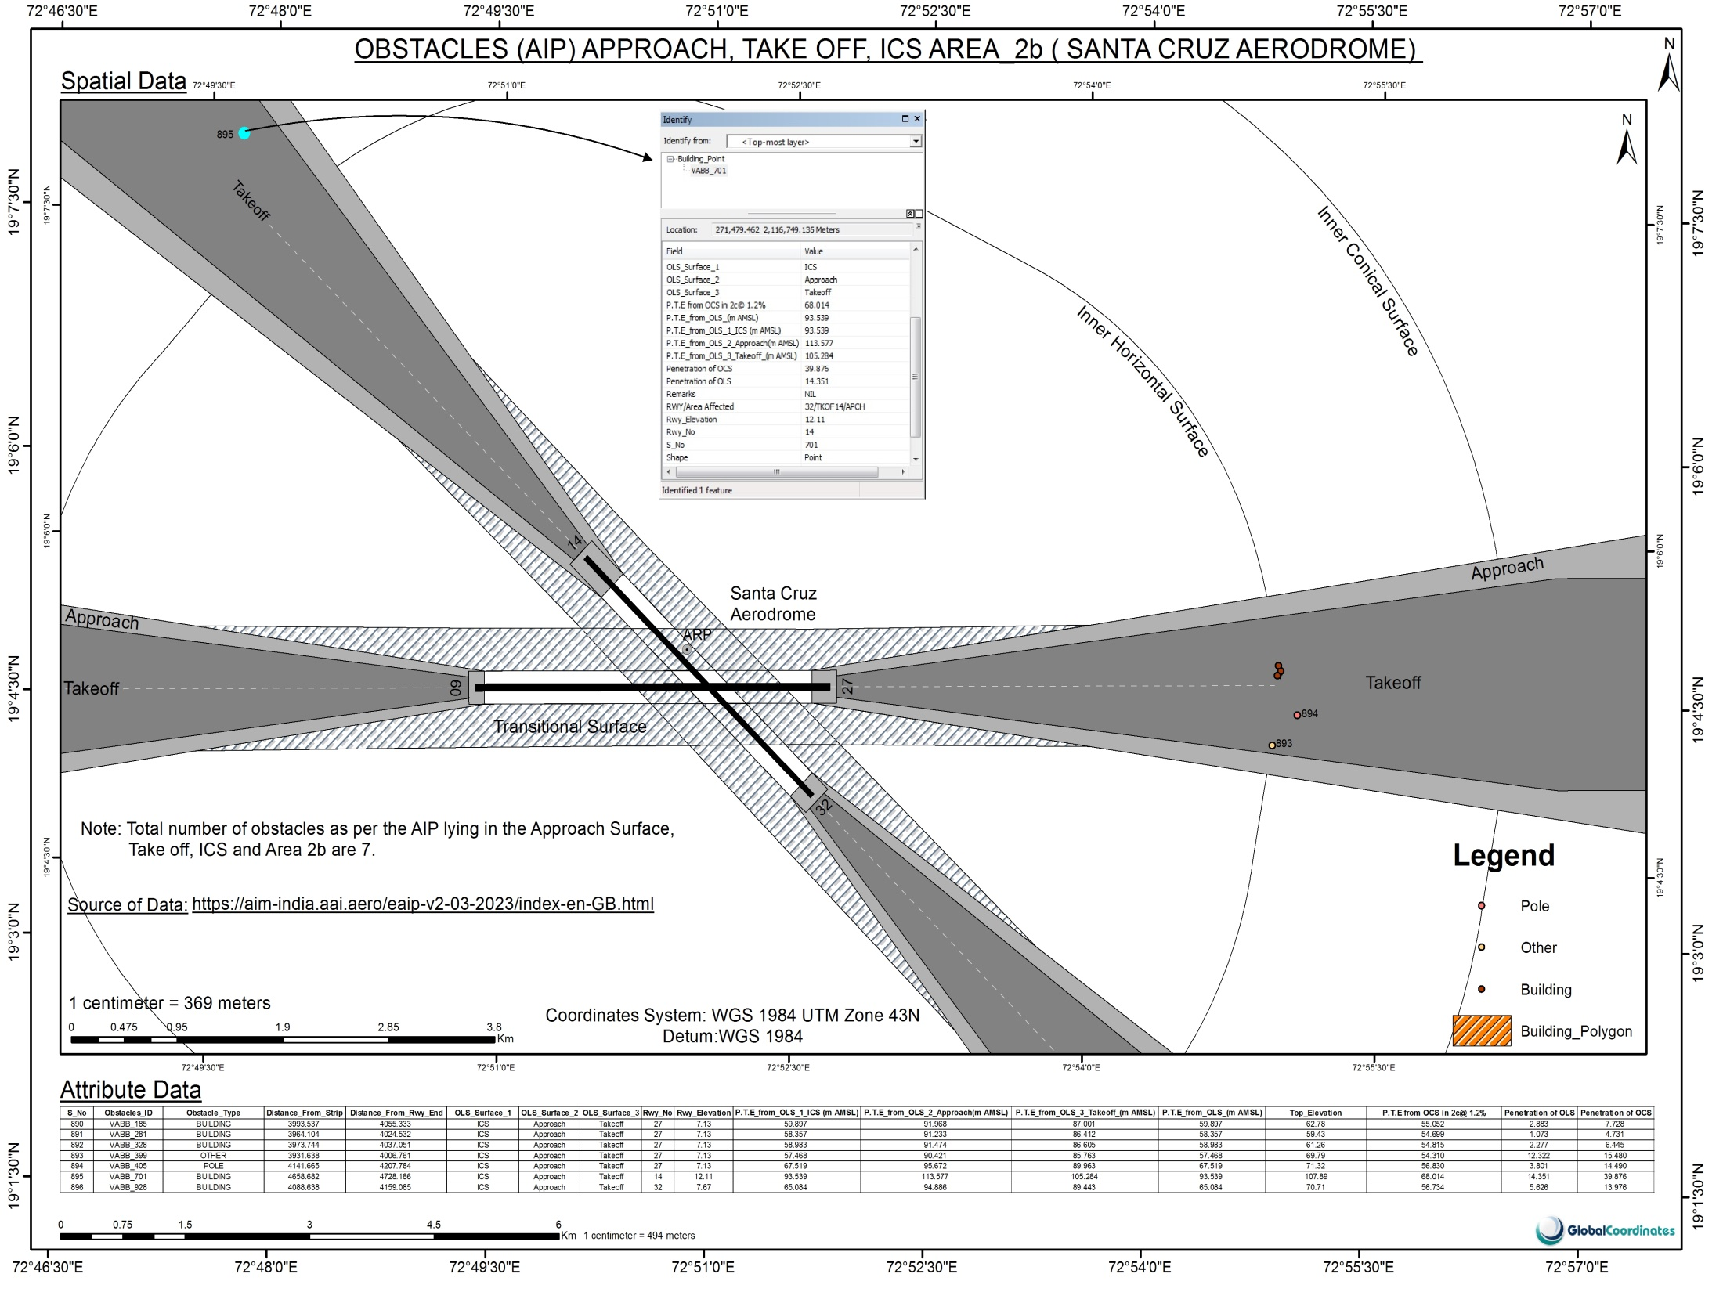

Slide 21
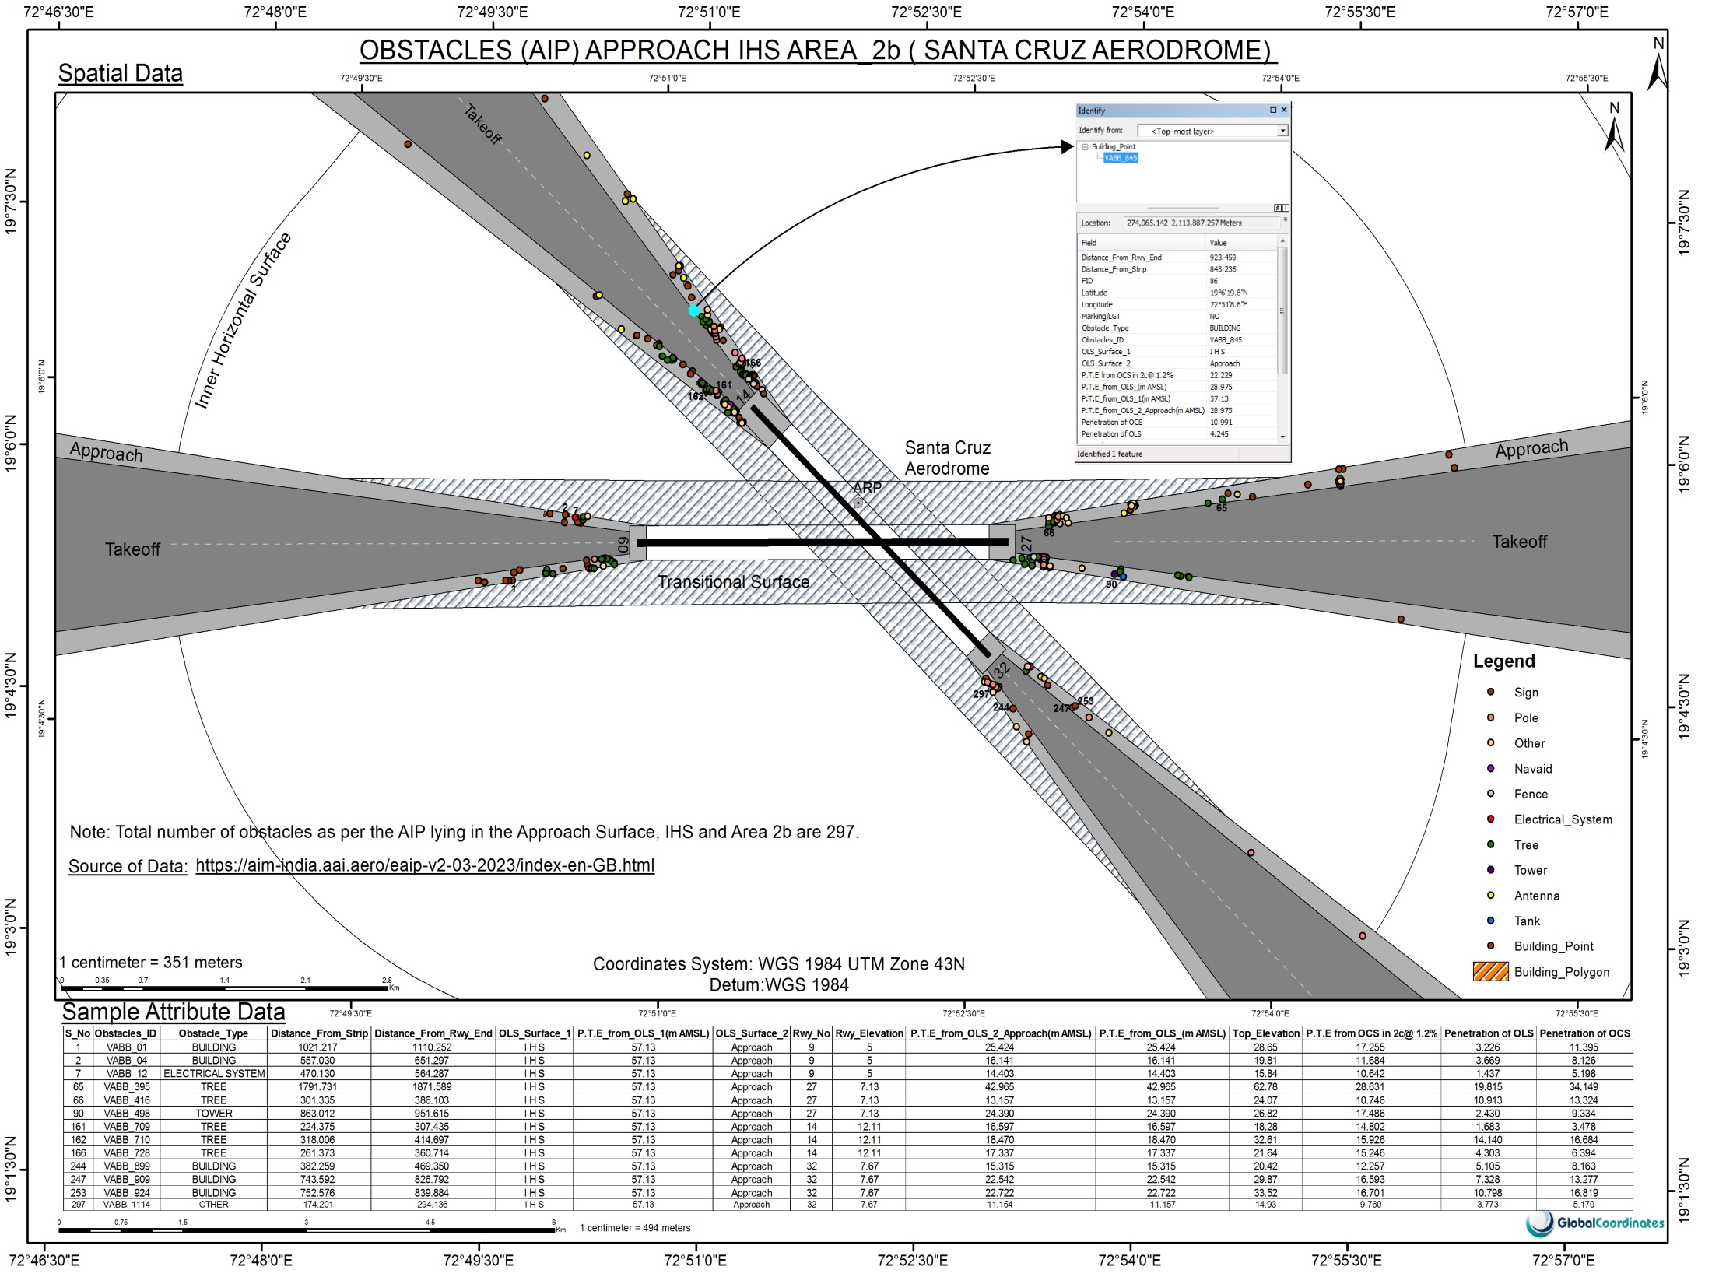

Slide 22
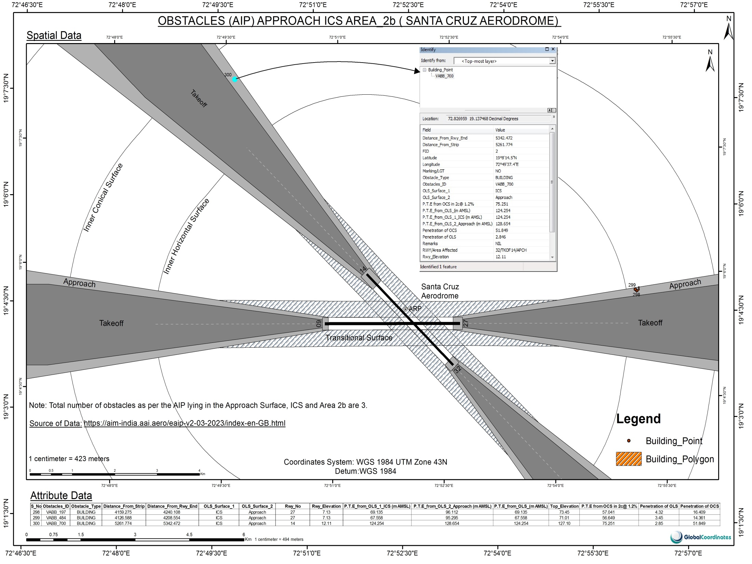

Slide 23
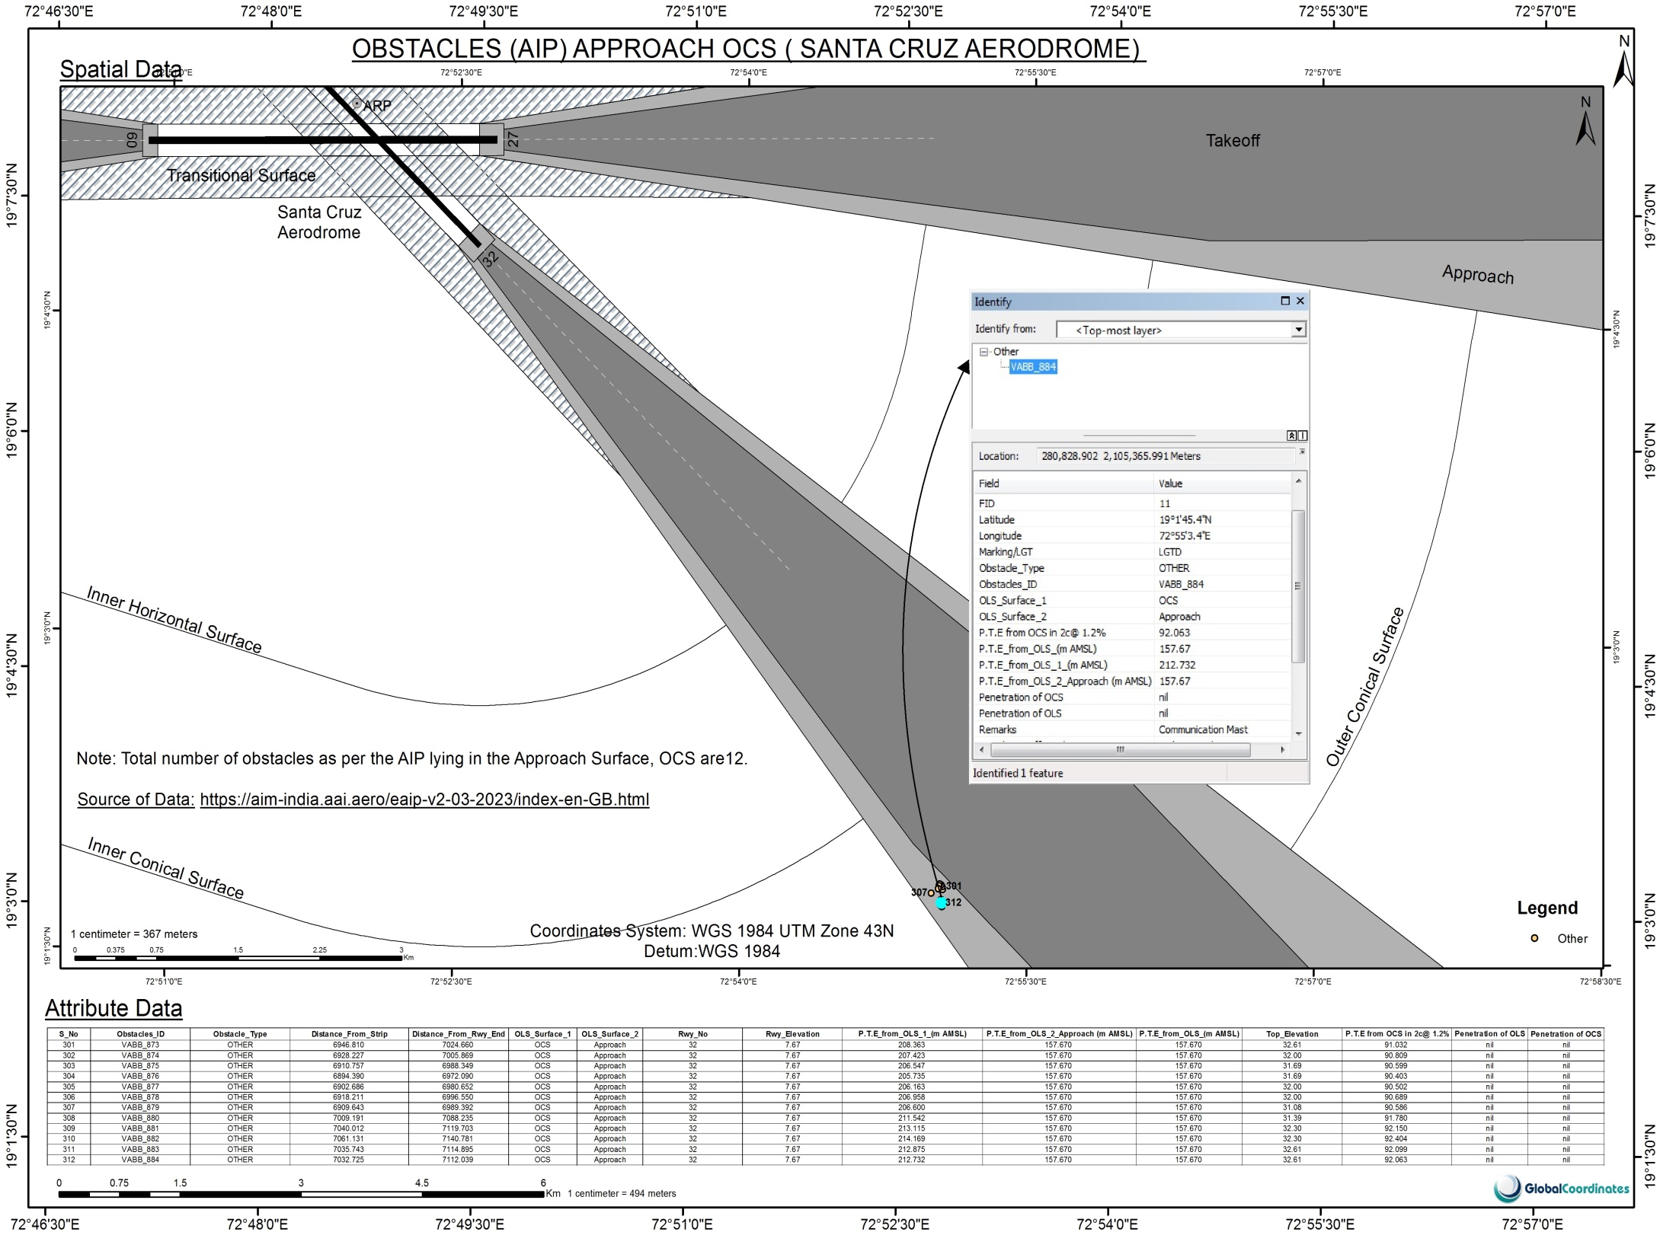

Slide 24
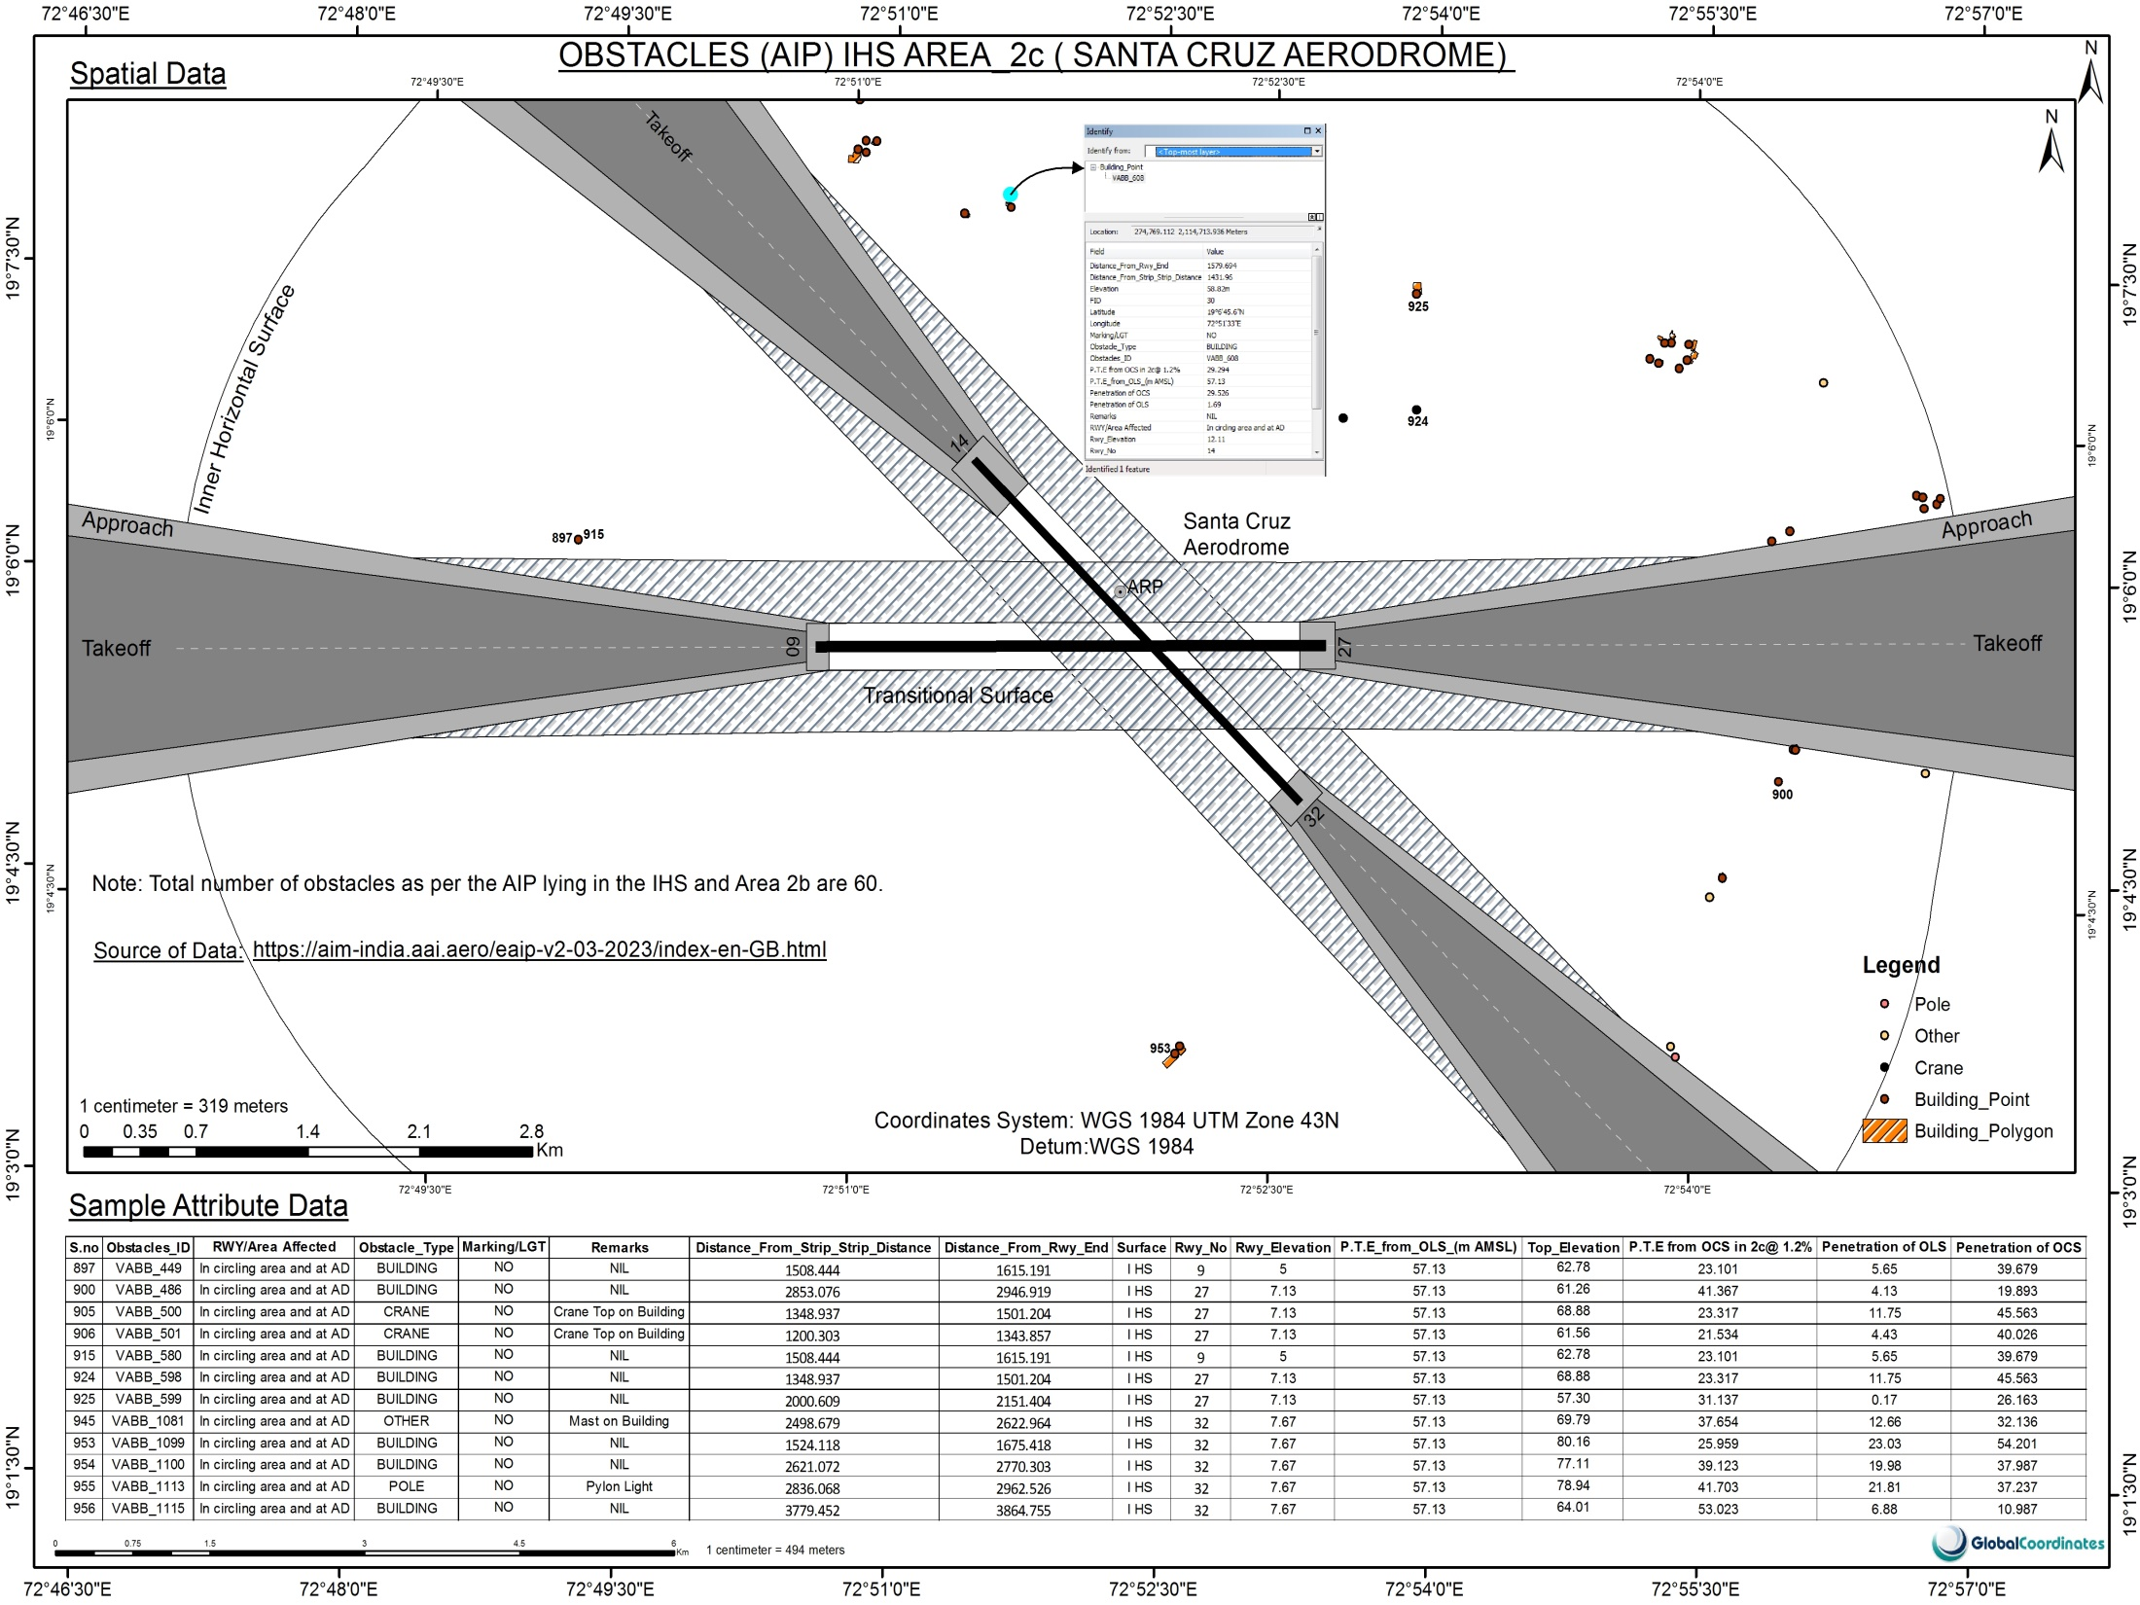

Slide 25
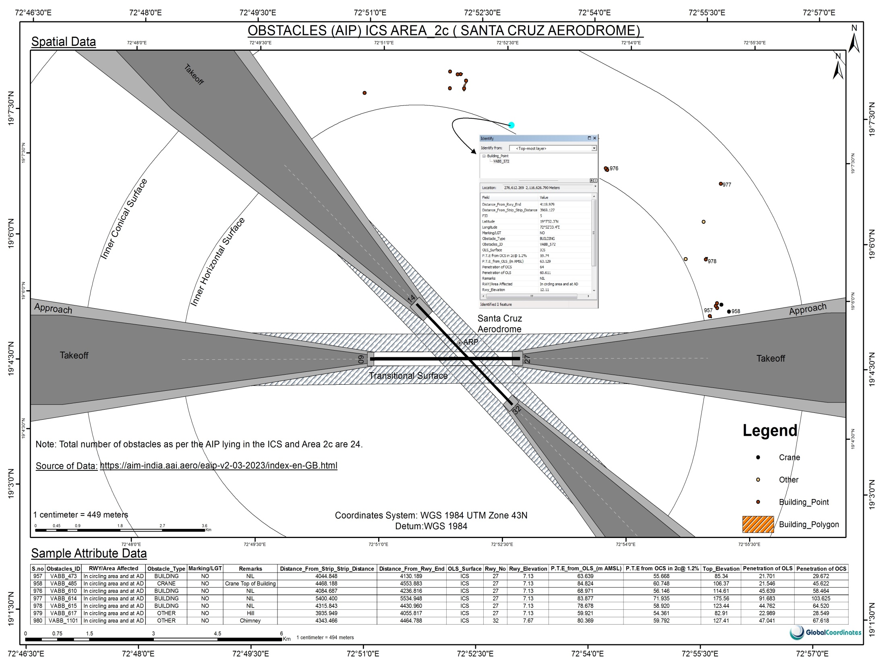

Slide 26
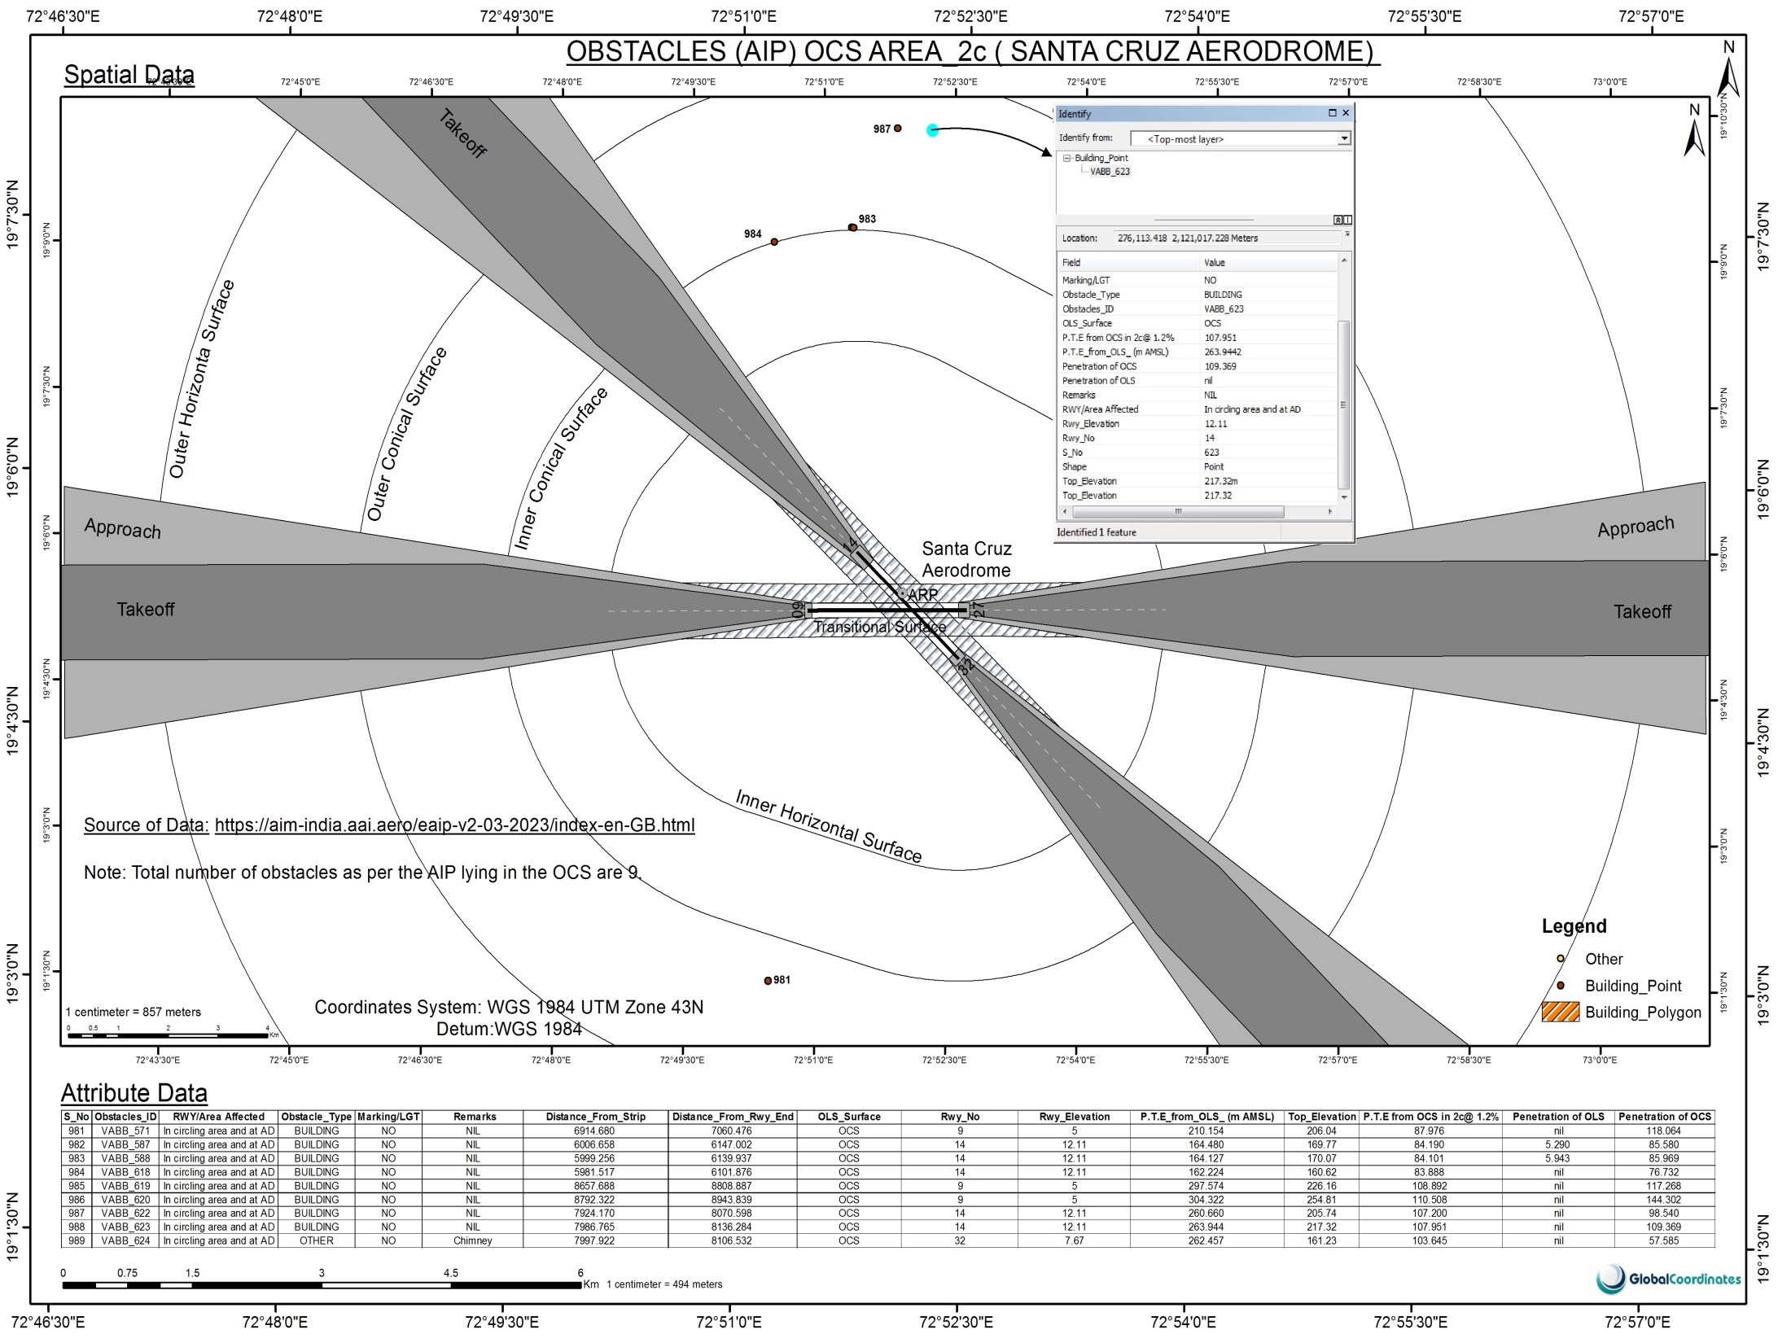

Slide 27
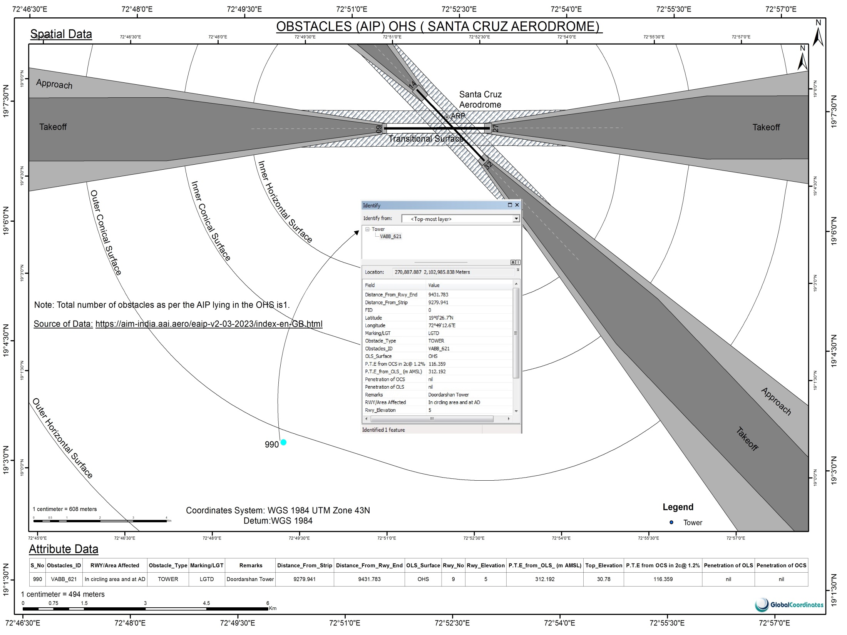

Slide 28
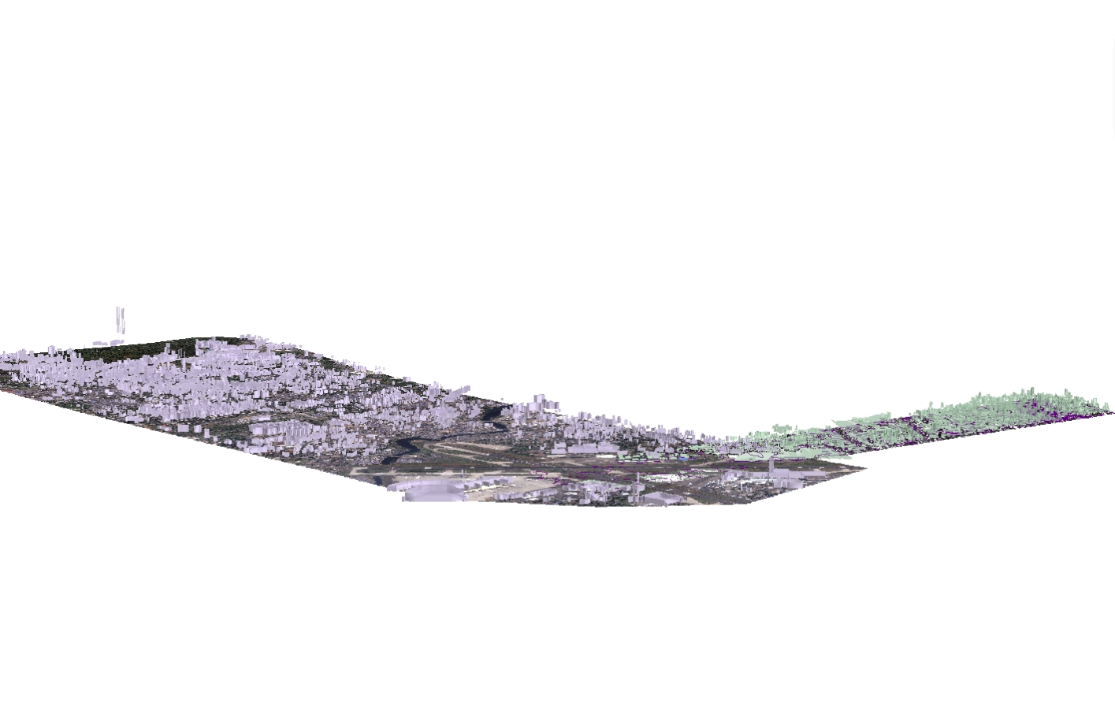
Summary
The total obstacles captured from AIP are : 1118
The total number of obstacles captured from data mining of Appeal process are : 166
Therefore in all there are 1284 obstacles with the attribute data attached.
Please also see the following annexures attached along with the presentation:
Obstacle Report in excel format.
Sample excel sheet with calculations.

