Slide 1

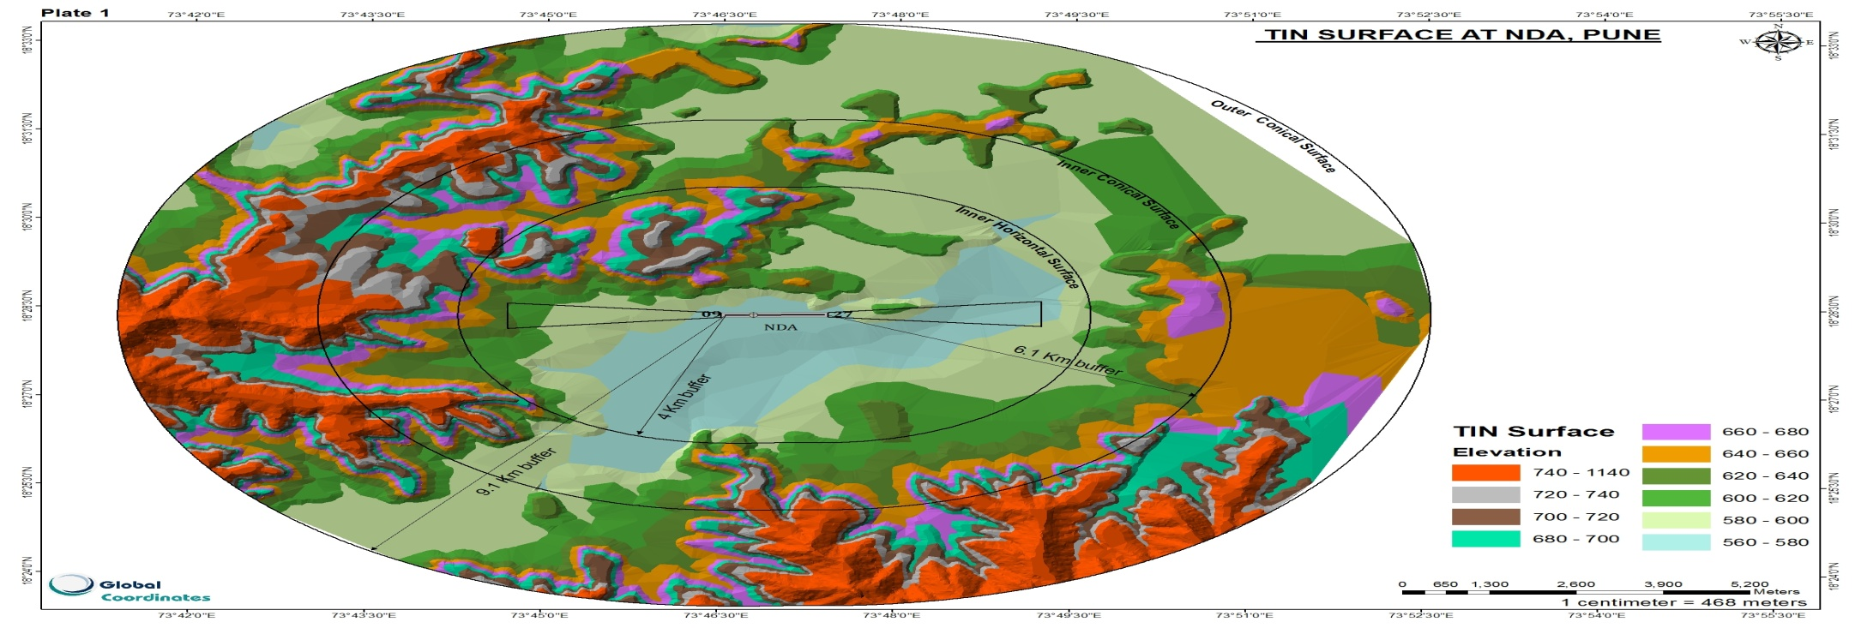
“Like failure, chaos contains information that can lead to knowledge -- even wisdom. Like art.“ Toni Morrison
WHAT IS TOD?
Webinar dated October 20, 2021
Time: 10:00am -12:00 hours
Hosted and conducted by : M/s Global Coordinates with FLYGHT7

Slide 2

Need for digital datasets of terrain and obstacles
A key driver for the transition from AIS to AIM is the need to achieve an uninterrupted aeronautical data chain with no loss or corruption in information, in a pre-defined format and with guaranteed accuracy and integrity. The aeronautical data chain is defined as “a series of interrelated links wherein each link provides a function that facilitates the origination, transmission and use of aeronautical data for a specific purpose”.

Slide 3
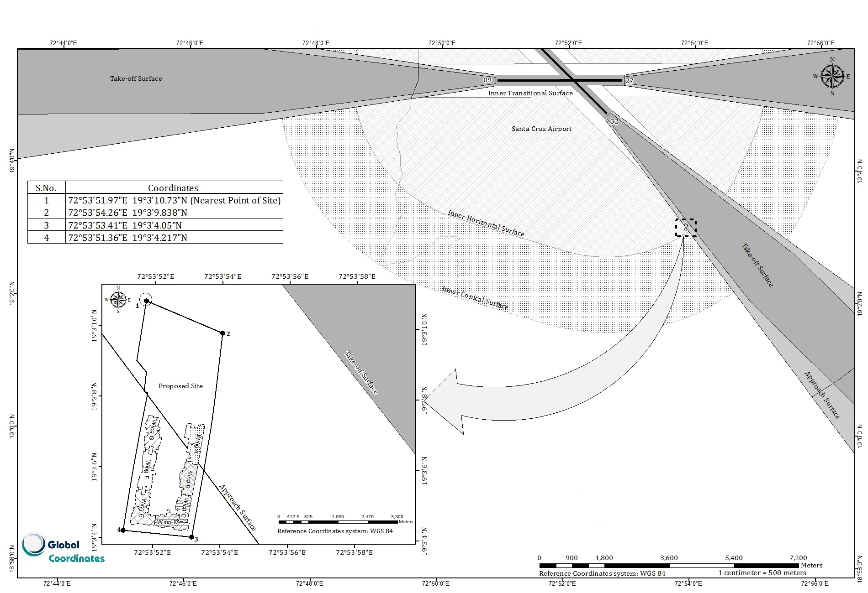
OBSTACLE EXTENDING INTO APPROACH SURFACE

Slide 4
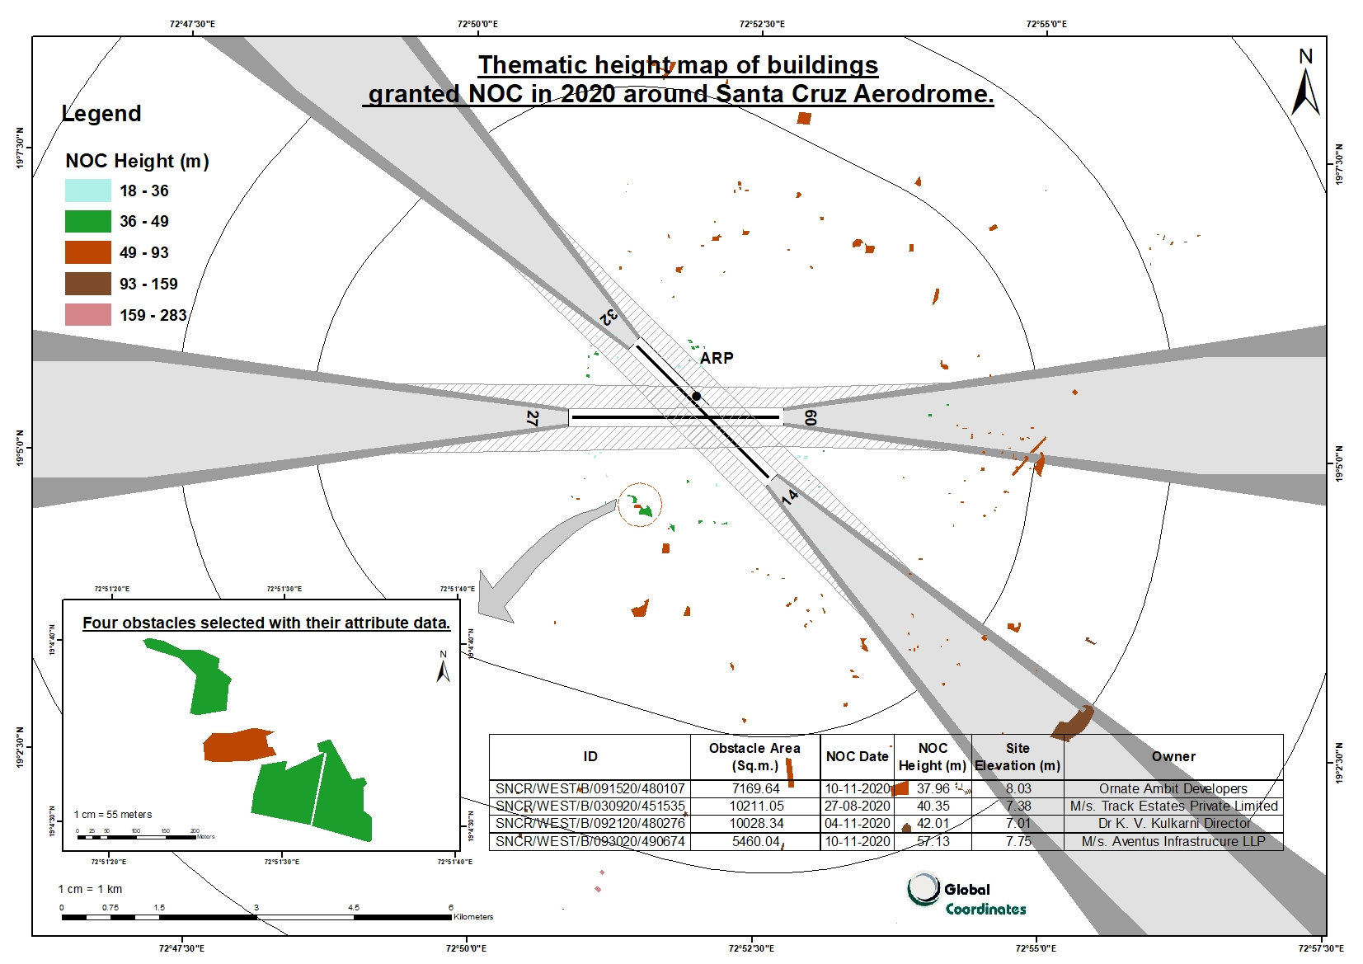

Slide 5
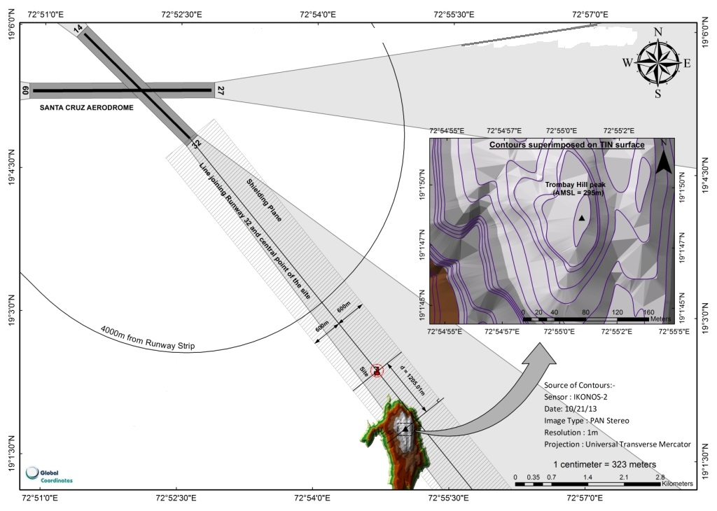
NEED FOR TERRAIN DATA FOR PROCEDURE DESIGN

Slide 6
Electronic vs. Digital data
Electronic data is typically in the form of documentation that is static. It is a file - whether workable or not. The majority of distributed documentation is in a non modifiable format, such as a .pdf file, either scanned with signatures, or rendered from the modifiable format. The files are electronically tangible, we can see them, work with them, update them.
Digital data on the other hand, while it may also be manipulated and seen (and could even be printed as a document), is bytes of information that is integrated across different systems, or can have cause and effect on physical components. It includes the metadata of any object, normally the data about an electronic file.

Slide 7
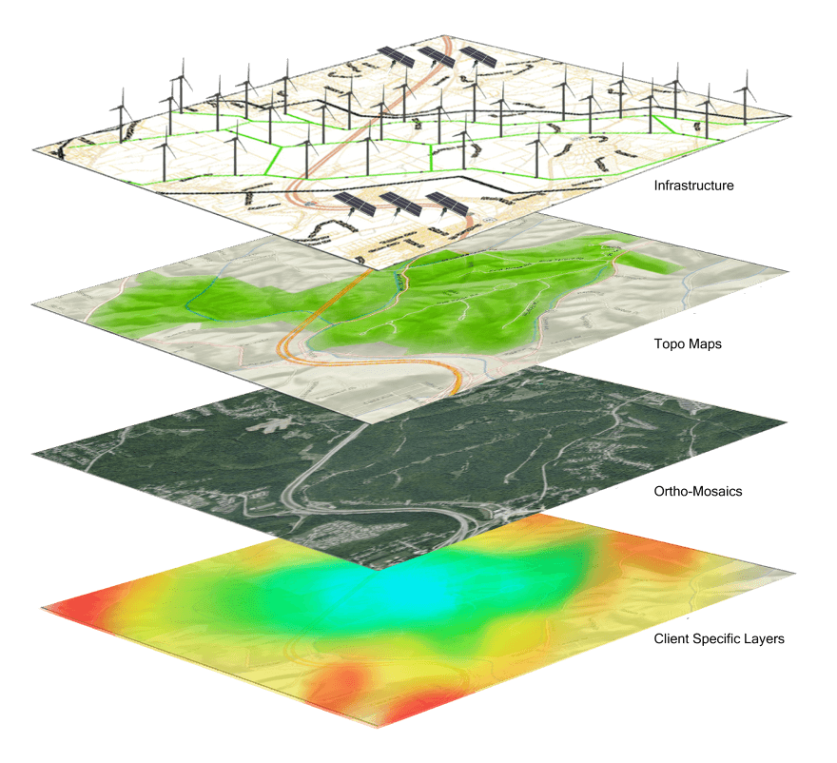
GIS: The first step for Digital Datasets
A geographic information system (GIS) is a system designed to capture, store, manipulate, analyze, manage, and present spatial or geographic data
.
GIS = G + IS
Spatial Data
In the form of point, line, polygon
Non Spatial Data
Information System
(Spatial Coordinates on the Surface of the earth
Attribute data (tabular data) corresponding to the spatial feature
Connected by UID
GIS allows multiple layers of information to be displayed on a single map

Slide 8
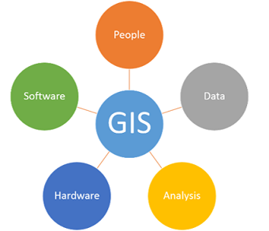
What is a GIS?
A geographic information system (GIS) is a system designed to capture, store, manipulate, analyze, manage, and present all types of geographical data. The key word to this technology is Geography – this means that some portion of the data is spatial. In other words, data that is in some way referenced to locations on the earth.
Coupled with this data is usually tabular data known as attribute data. Attribute data can be generally defined as additional information about each of the spatial features. An example of this would obstacles. The actual location of the obstacles is the spatial data. Additional data such as the obstacle type, horizontal accuracy, vertical accuracy and others as mentioned in Table A1-6 of Appendix 1 of PANS AIM Doc, make up the attribute data.
Vector data includes spatial features (points, lines, and polygons) and attributes about that data (descriptive information).
Raster data are stored electronic images (data is stored in pixels such as aerial photograph , satellite images, DEM/DTM and TIN surfaces).
Analysis is the process of using the intelligent database to answer questions. There are many different analysis techniques.
Geographic Information Systems require specialized software. The most commonly used GIS software include ArcGIS and QGIS (which is open source).

Slide 9
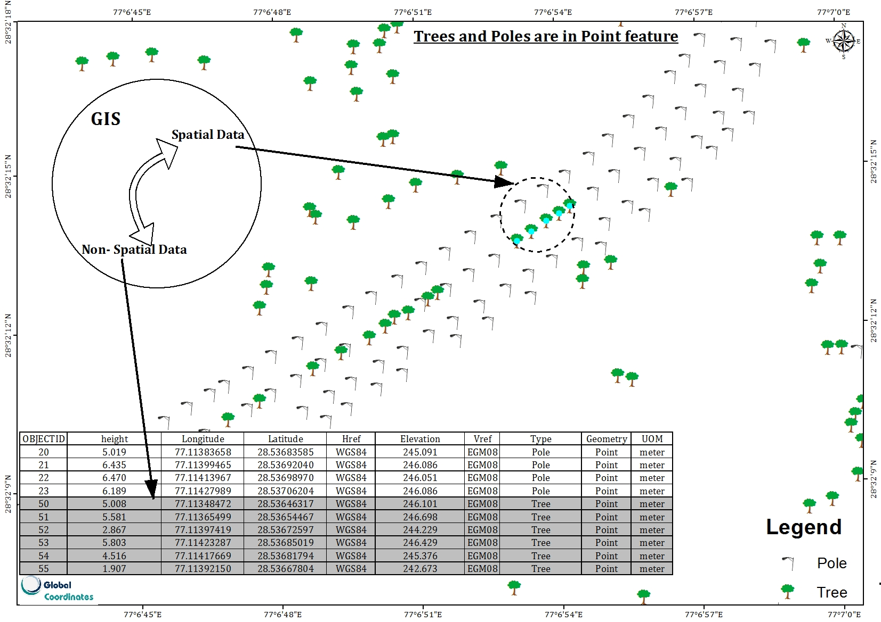
Connected by UID

Slide 10
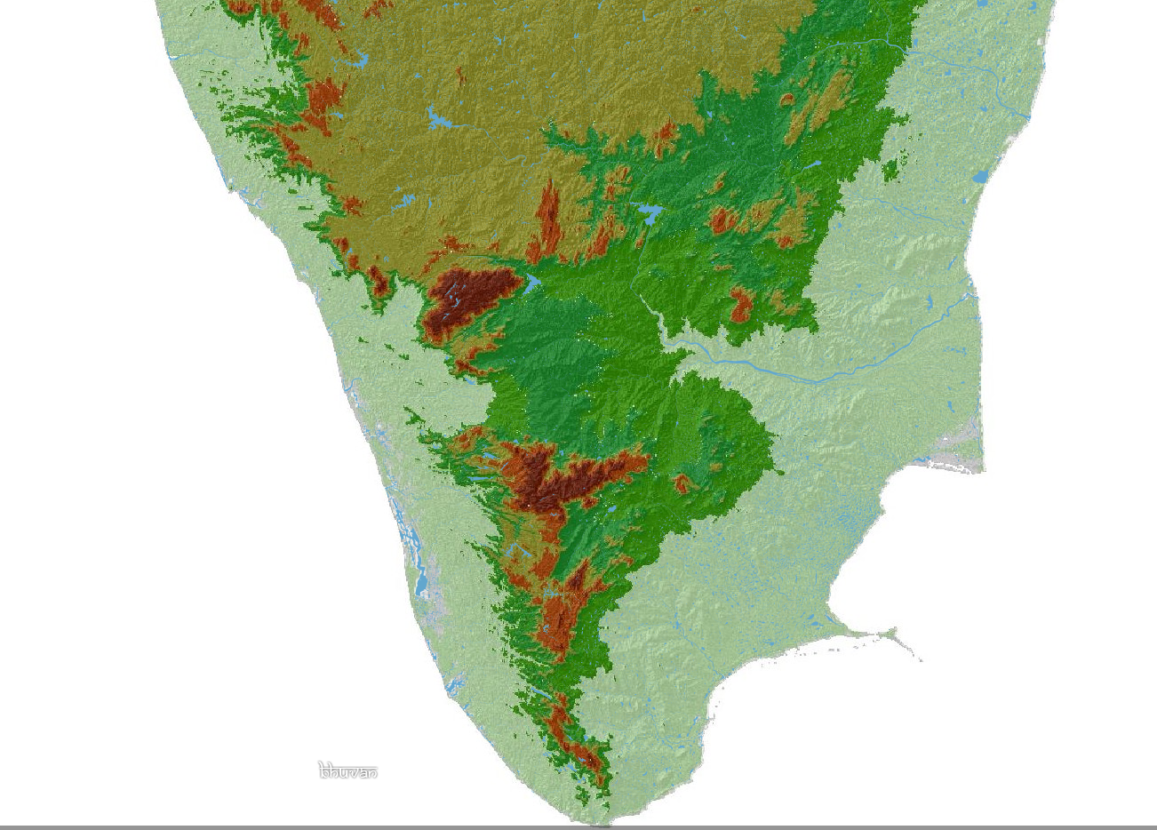
TERRAIN DATA
CIVIL AVIATION REQUIREMENTS SERIES I PART I SECTION 9 , 8th JANUARY 2010 , Rev. 6, 20th September 2021
5.3.3.3 Terrain Data Sets
5.3.3.3.1 Terrain data sets shall contain the digital representation of the terrain surface in the form of continuous elevation values at all intersections (points) of a defined grid, referenced to common datum.
Source: https://bhuvan.nrsc.gov.in/

Slide 11
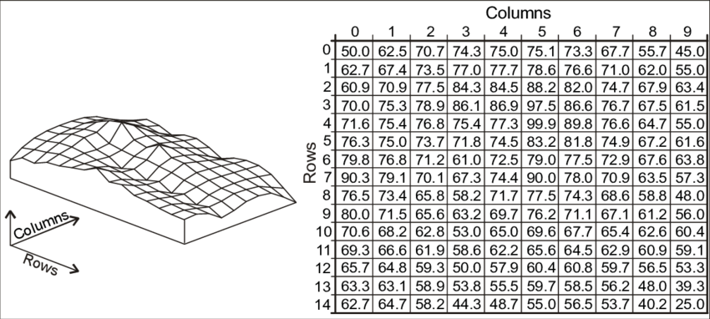
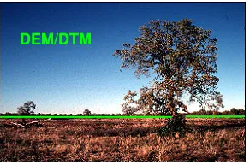
What is DEM?
A Digital Elevation Model (DEM) is a representation of the bare ground (bare earth) topographic surface of the Earth excluding trees, buildings, and any other surface objects.
Digital Elevation Models (DEMs) are raster files with elevation data for each raster cell.
DEM can be produced by automatic DEM extraction from stereo satellite scenes such as Cartosat-1 Stereo data of 2.5m resolution ( Each Scene covers 27.5km x27.5km) from NRSC.
Or off the shelf CartoDEM data (10m contours) (Each scene covers 14km x 14 km) from NRSC.

Slide 12
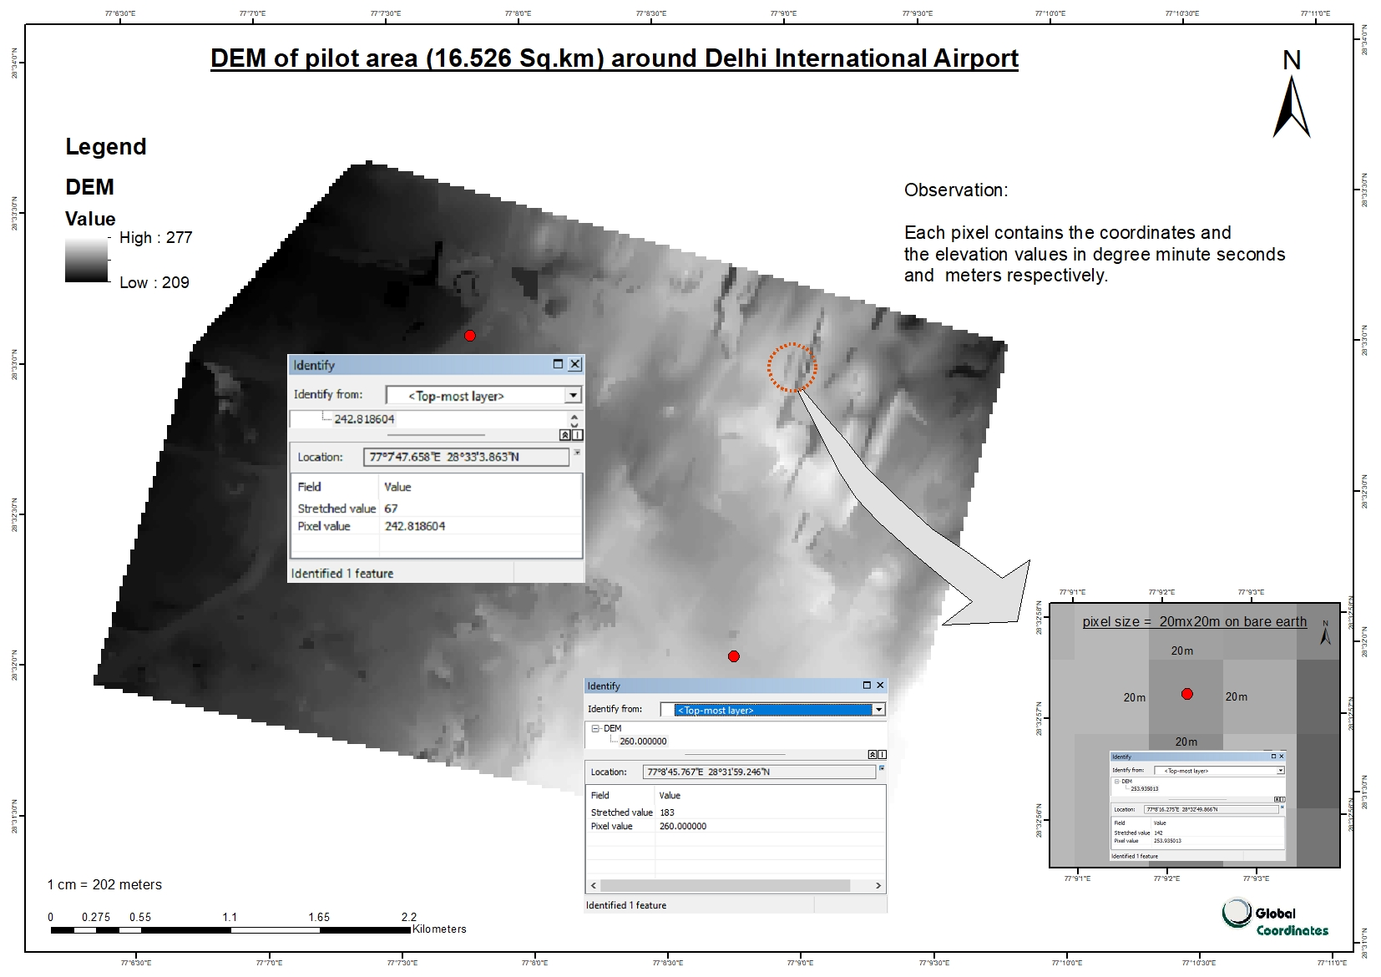
A DEM can be represented as a raster (a grid of squares, also known as a height map when representing elevation) or as a vector-based triangular irregular network (TIN).

Slide 13
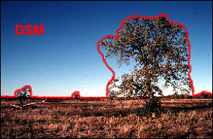
What is a DSM?
Digital Surface Model (DSM) represents the MSL elevations of the reflective surfaces of trees, buildings, and other features elevated above the “Bare Earth”.

Slide 14
Terrain data: Shall/Mandatory CIVIL AVIATION REQUIREMENTS SERIES I PART I SECTION 9 , 8th JANUARY 2010 , Rev. 6, 20th September 2021
Sec 5.3.3.2: For aerodromes regularly used by international civil aviation, terrain data shall be provided
for :
Area 1
Area 2a
Take-off flight path Area
An area bounded by the lateral extents of the aerodrome obstacle limitation surfaces.
Sec 5.3.3.3.7: For aerodromes regularly used by international civil aviation, terrain data shall be provided for Area 4, for all runways where precision approach category II or III operations have been established and where detailed terrain information is required by operators to enable them to assess the effect of terrain on decision height determination by use of radio altimeters.
[Sets of electronic terrain data shall include spatial ( position and elevation), thematic and temporal aspects for the surface of the Earth containing naturally occurring features such as mountains, hills, ridges, valleys, bodies of water, permanent ice and snow, excluding obstacles. This shall represent the continuous surface that exists at the bare earth, the top of the canopy or something in between, also known as the ‘first reflective surface’.]
Terrain features attributes: Table A 6-1

Slide 15
TERRAIN ATTRIBUTES
Appendix 6
Table A6-1. Terrain attributes
Terrain attribute |  |  | Mandatory/Optional
Area of coverage |  |  | Mandatory
Data originator identifier |  |  | Mandatory
Data source identifier |  |  | Mandatory
Acquisition method |  |  | Mandatory
Post spacing |  |  | Mandatory
Horizontal reference system |  |  | Mandatory
Horizontal resolution |  |  | Mandatory
Horizontal accuracy |  |  | Mandatory
Horizontal confidence level |  |  | Mandatory
Horizontal position |  |  | Mandatory
Elevation |  |  | Mandatory
Elevation reference |  |  | Mandatory
Vertical reference system |  |  | Mandatory
Vertical resolution |  |  | Mandatory
Vertical accuracy |  |  | Mandatory
Vertical confidence level |  |  | Mandatory
Surface type |  |  | Optional
Recorded surface |  |  | Mandatory
Penetration level |  |  | Optional
Known variations |  |  | Optional
Integrity |  |  | Mandatory
Date and time stamp |  |  | Mandatory
Unit of measurement used |  |  | Mandatory

Slide 16
Obstacle data: Shall/Mandatory CIVIL AVIATION REQUIREMENTS SERIES I PART I SECTION 9 , 8th JANUARY 2010 , Rev. 6, 20th September 2021
Sec 5.3.3.4.1: Obstacle data sets shall contain the digital representation of the vertical and horizontal extent of obstacles.
[ PANS AIM Doc 10066 5.3.3.2.2.1 Obstacle data elements are features that shall be represented in the data sets by points, lines or polygons]
Sec 5.3.3.4.3: The obstacle data shall be provided for obstacles in Area 1 whose height is 100m or higher above ground.
Sec 5.3.3.4.4: For aerodromes regularly used by international civil aviation, obstacle data shall be provided for all obstacles within Area 2 that are assessed as being a hazard to air navigation.
Sec 5.3.3.4.5: For aerodromes regularly used by international civil aviation, obstacle data shall be provided for:
a) Area 2a: for those obstacles that penetrate an obstacle data collection surface outlined by a rectangular area around a runway that comprises the runway strip plus any clearway that exists. The Area 2a obstacle collection surface shall have height of 3 m above the nearest runway elevation measured along the runway centre line, and for those portions related to a clearway, if one exists, at the elevation of nearest runway end;
b) Objects in the take-off flight path area which project above a plane surface having a 1.2 per cent slope and having a common origin with the take-off flight path area; and
c) penetrations of the aerodrome obstacle limitation surfaces.
[Note.— Take-off flight path area are specified in Annex 4, 3.8.2. Aerodrome obstacle limitation surfaces are specified in Annex 14, Volume 1, Chapter 4. ]
Sec 5.3.3.4.10 f or Aerodromes regularly used by international civil aviation, obstacle data shall be provided for Area 4, for all runways where precision approach Category II or III operations have been established.
.
Obstacle features attributes: Table A 6-2

Slide 17
OBSTACLE ATTRIBUTES
Appendix 6
Table A6-2. Obstacle attributes
Obstacle attribute |  |  | Mandatory/Optional
Area of coverage |  |  | Mandatory
Data originator identifier |  |  | Mandatory
Data source identifier |  |  | Mandatory
Obstacle identifier |  |  | Mandatory
Horizontal accuracy |  |  | Mandatory
Horizontal confidence level |  |  | Mandatory
Horizontal position |  |  | Mandatory
Horizontal resolution |  |  | Mandatory
Horizontal extent |  |  | Mandatory
Horizontal reference system |  |  | Mandatory
Elevation |  |  | Mandatory
Height |  |  | Optional
Vertical accuracy |  |  | Mandatory
Vertical confidence level |  |  | Mandatory
Vertical resolution |  |  | Mandatory
Vertical reference system |  |  | Mandatory
Obstacle type |  |  | Mandatory
Geometry type |  |  | Mandatory
Integrity |  |  | Mandatory
Date and time stamp |  |  | Mandatory
Unit of measurement used |  |  | Mandatory
Operations |  |  | Optional
Effectivity |  |  | Optional
Lighting |  |  | Mandatory

Slide 18
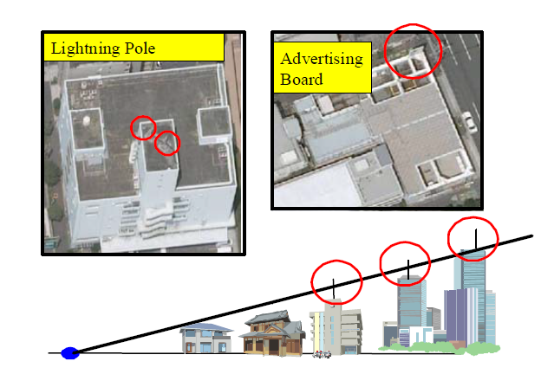
Basic concept of obstacle extraction
Obstacle collection surface or Obstacle limiting Surface

Slide 19
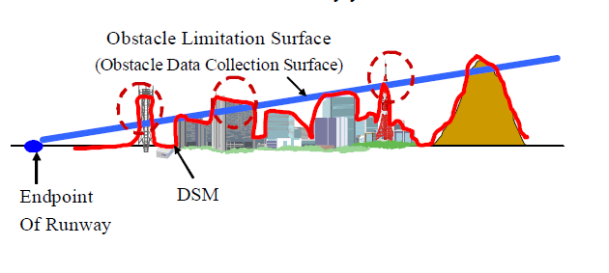
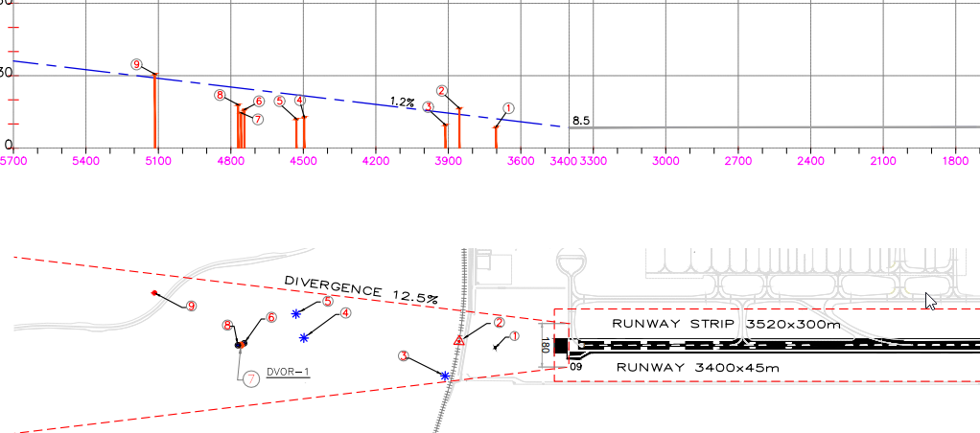
Obstacle Extraction
The identification of obstacles by means of spatial analysis of 3D OLS model and DSM has great potential as a cost-effective method.
The obstacles which do not penetrate the obstacle collection surface need not be shown on the chart.
Example: Obstacle 1, 3, 4, 5

Slide 20
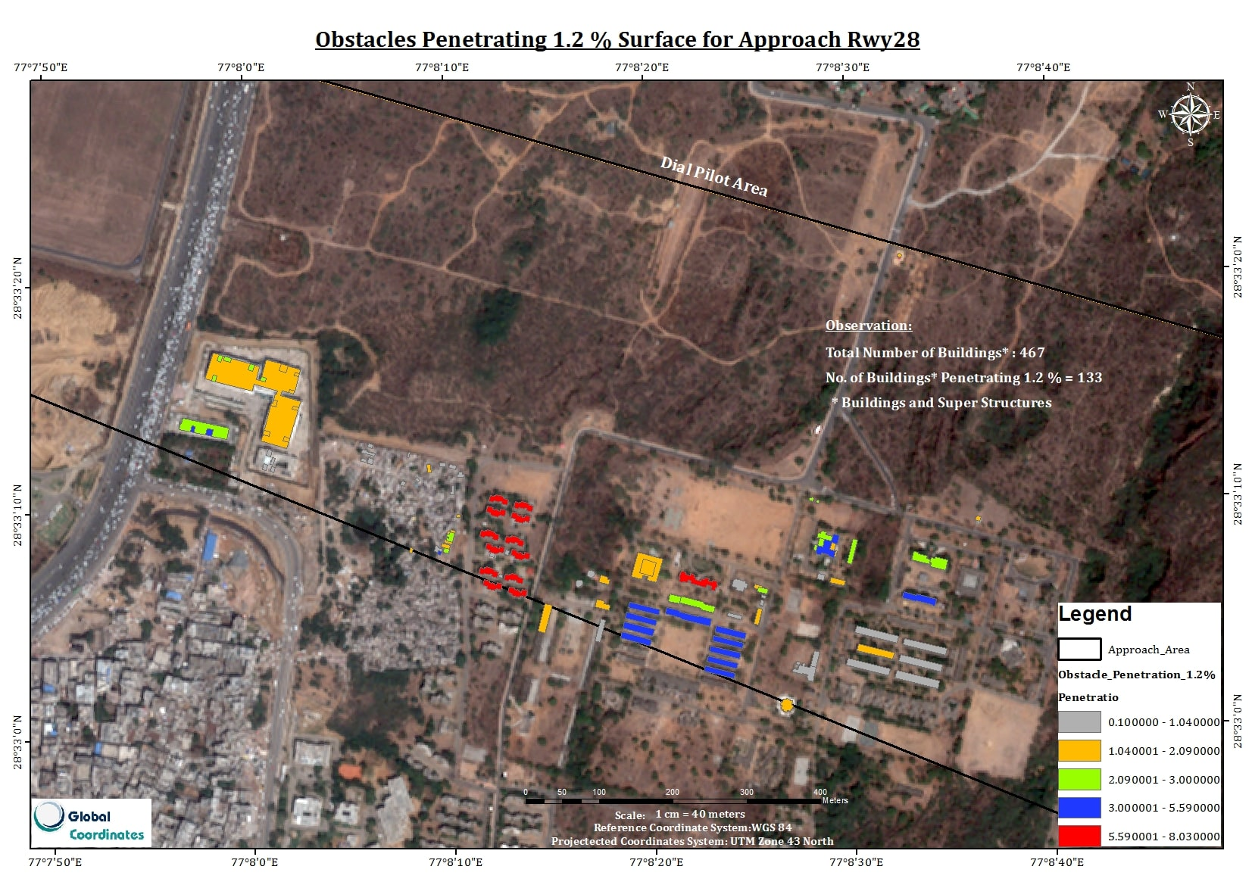

Slide 21
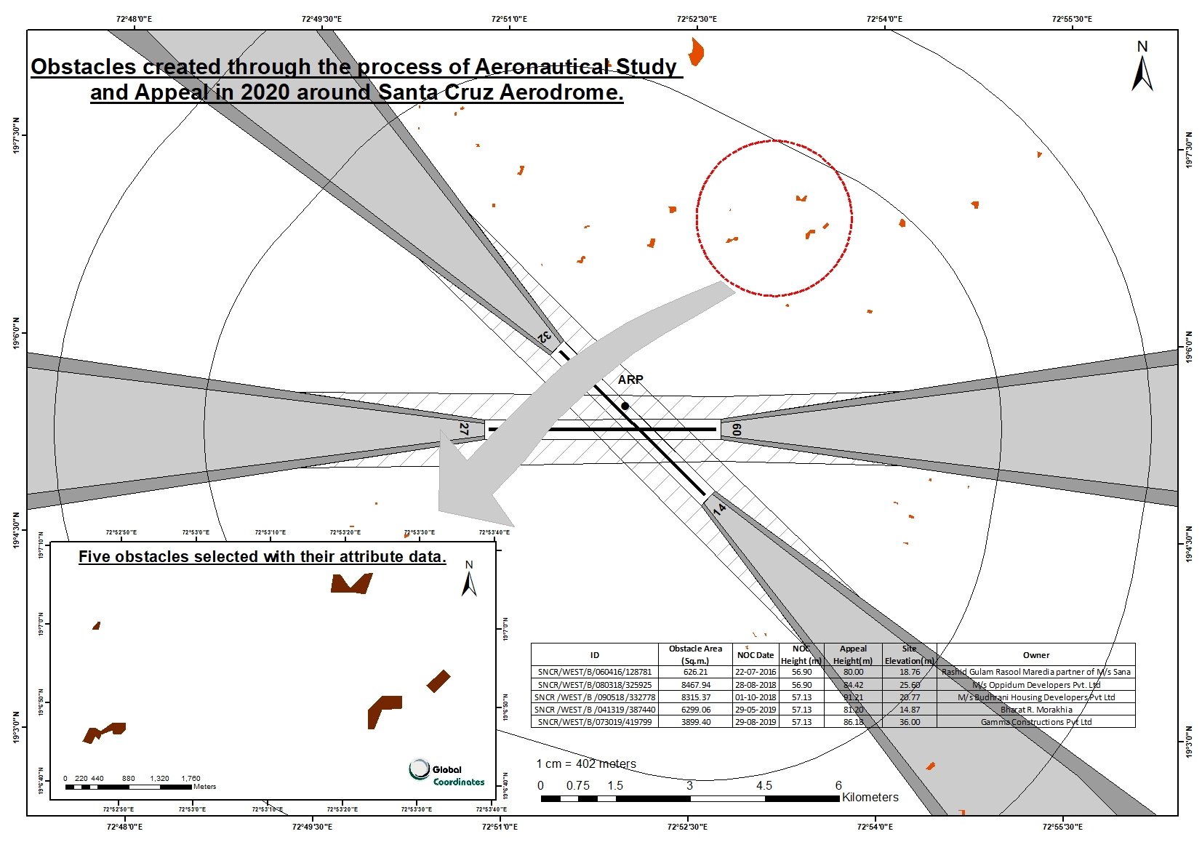

Slide 22
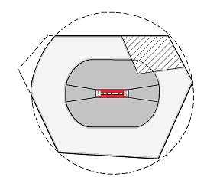
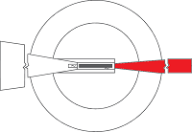

Mandatory areas for TOD: Area 2a, Take off flight path area, Area 4 [ Schematic diagram only ]
Take-off flight path area
Area 4
Area 2a
*Area1 is also mandatory

Slide 23




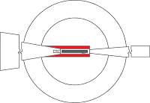


Mandatory areas for TOD: area bounded by the lateral extent of obstacle limitation surfaces [Schematic diagram only ]
IHS
Conical
Approach
Inner Approach
Inner Transitional
Balked landing
Transitional

Slide 24
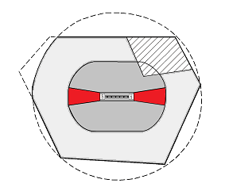
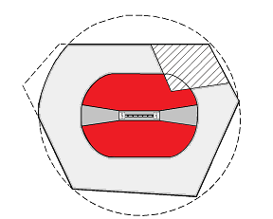
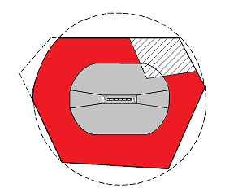

Recommended areas for Obstacle data: Area 2b, 2c, 2d and Area 3
Area 2b
Area 2c
Area 3
Area 2d

Slide 25
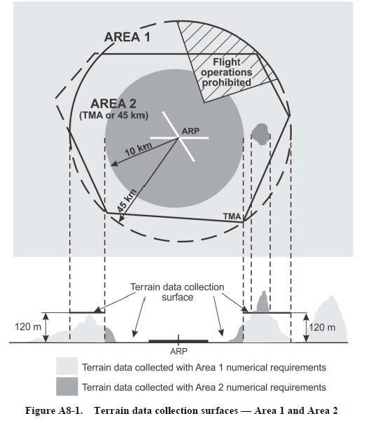
Recommended areas for Terrain data

Slide 26
