Slide 1
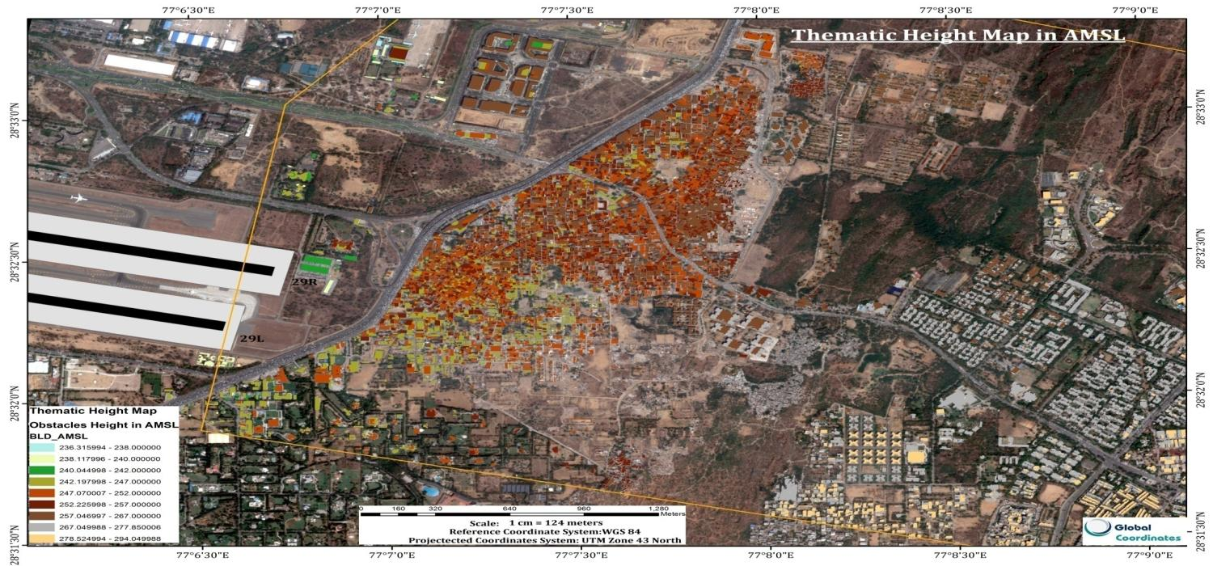
FROM AIS to AIM
CREATION OF eTOD USING HIGH RESOLUTION STEREO SATELLITE IMAGERY
PILOT PROJECT

Slide 2
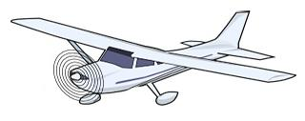
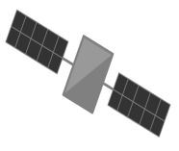

Technology comparison
Photogrammetry
3D modelling from a set of 2D photographs, done by taking two or more images of the same point from different angles.
LiDAR (Light Detection and Ranging)
Measures distances by illuminating a target with laser light.

Slide 3

Comparison between Lidar and satellite photogrammetry technologies
 | Satellite Photogrammetry | LiDAR
Data acquisition | Done via satellite by companies like Digital Globe, Airbus, ISRO. | Requires specialized and expensive equipment.
Cost | Affordable Runs in lacs for 100 sq. km | Expensive flight operation and equipment costs. Runs in Crores for 100 sq. km
Repeatability | Data can be updated as frequently as 1 week. | Prohibitively expensive to update data due to advanced flight permission and planning involved.
Accuracy | Better than 100cm | Better than 10cm
Manpower skill and software | Well developed software and workflows and enough skilled manpower available | Specialized software and skilled manpower is scarce.
Photorealistic modelling | High resolution modeling true color imaging possible | Not possible

Slide 4
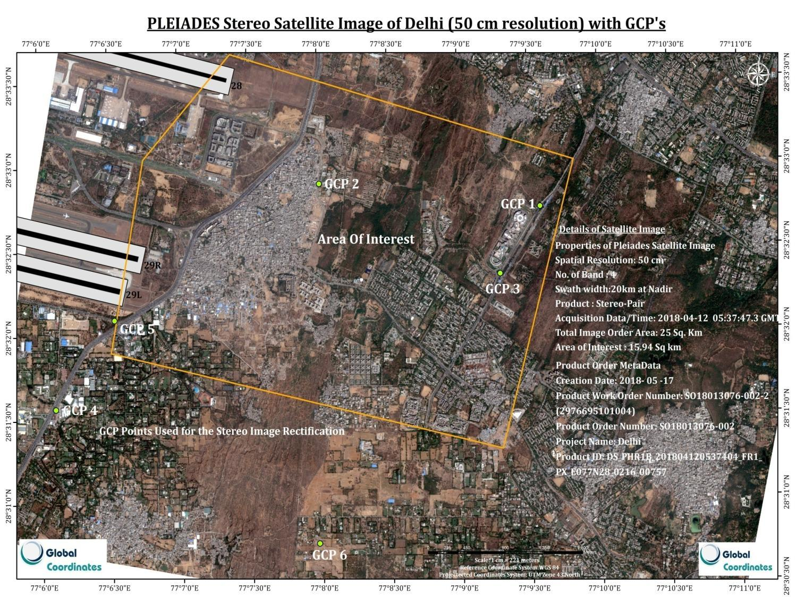

Slide 5

PROCESS FLOW CHART
Pleiades Stereo Satellite Image with 0.5 m Resolution
Ground Control Point Collection by DGPS
Image Correction
Aerial Triangulation
Radiometric & Spatial Enhancement
Accuracy (RMSE) Assessment
DEM Generation
Orthorectified Image
Extraction of buildings ,terrain and vegetation with their elevation data ( z values)

Slide 6
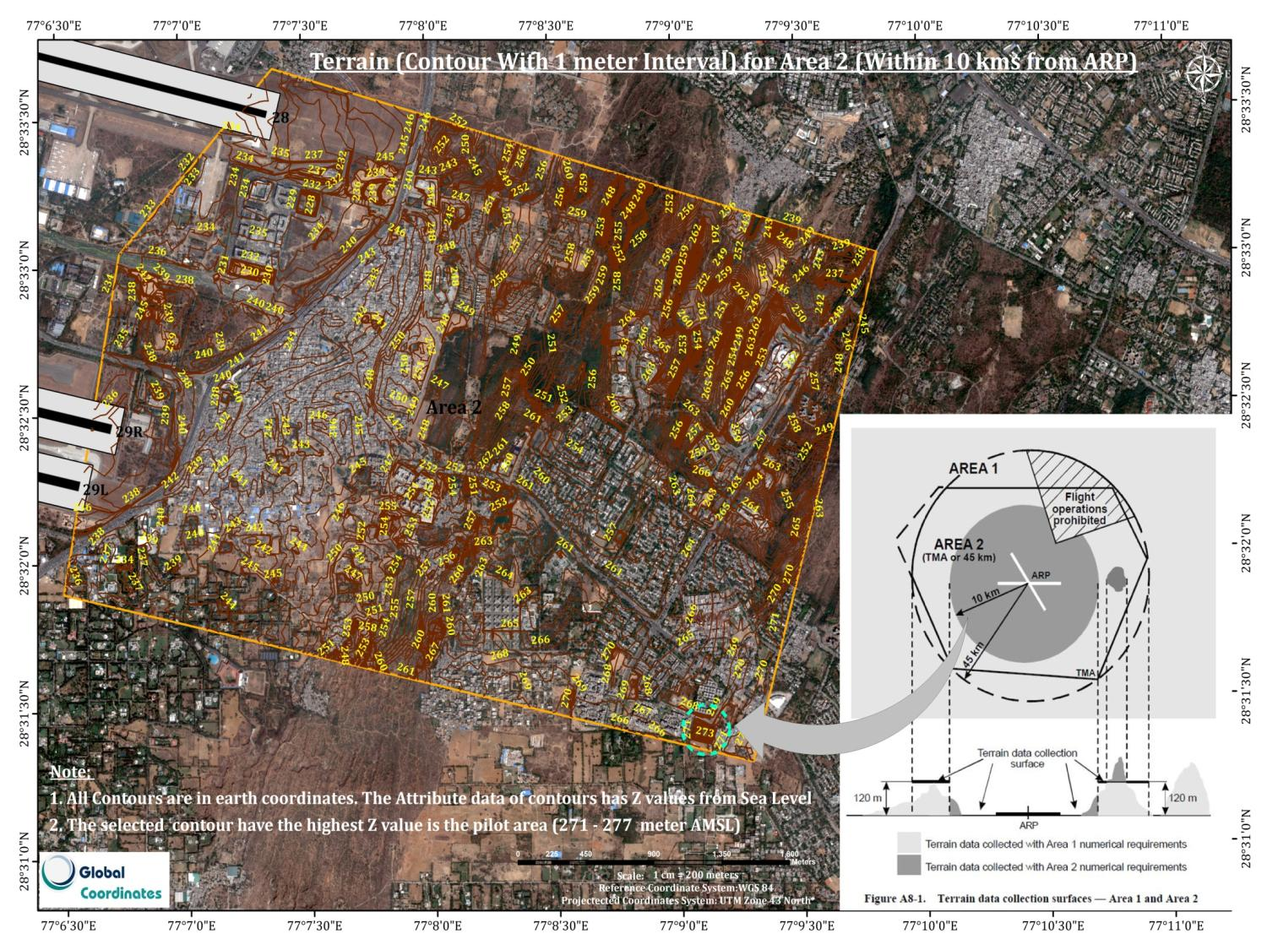

Slide 7
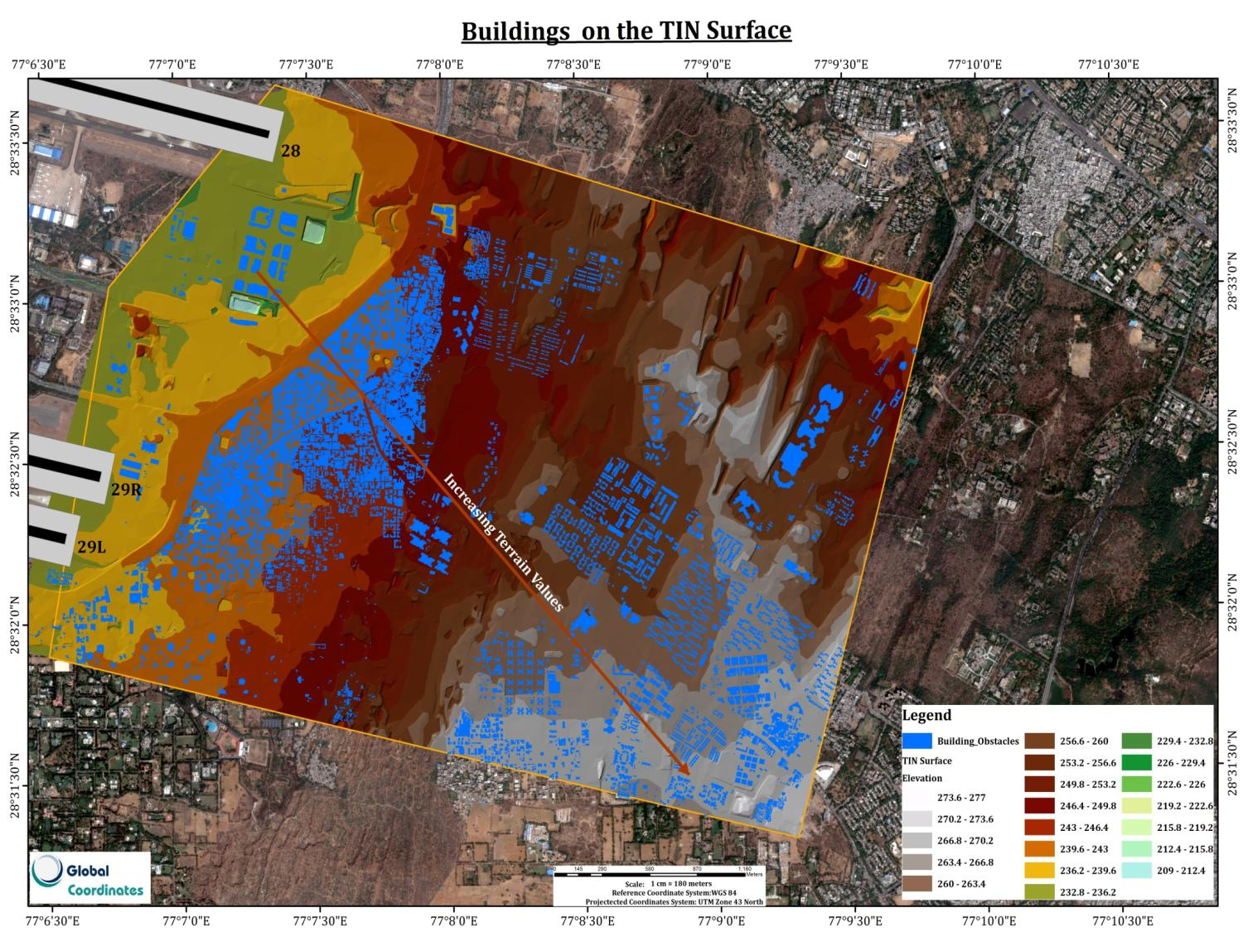


Slide 8
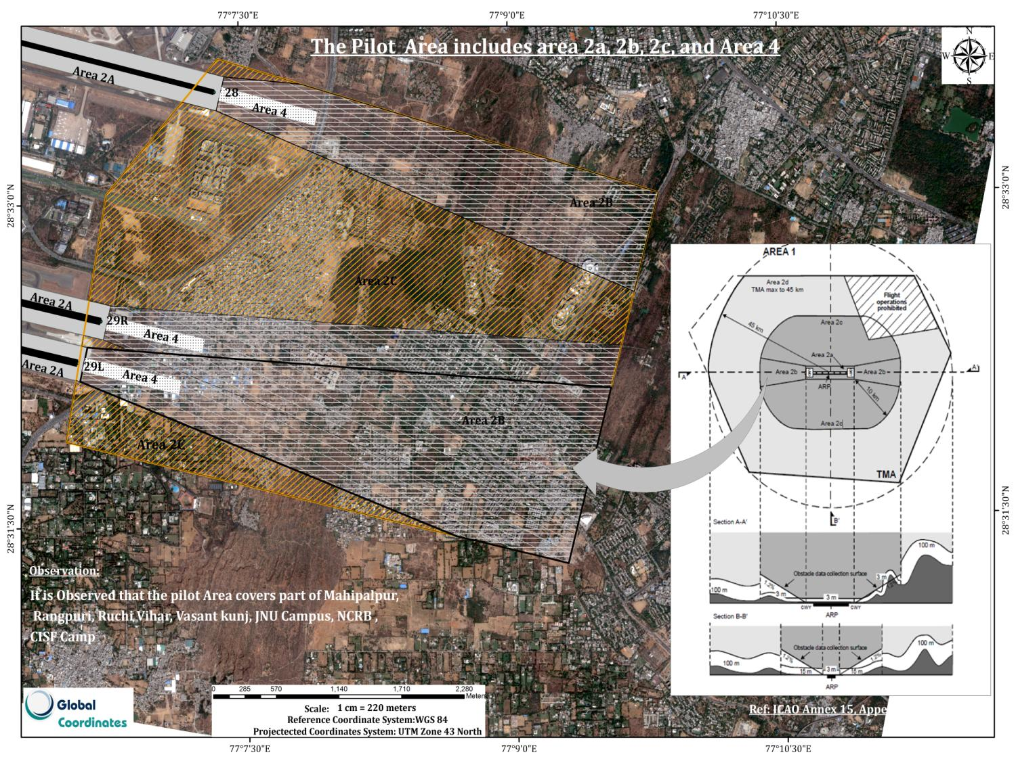

Slide 9
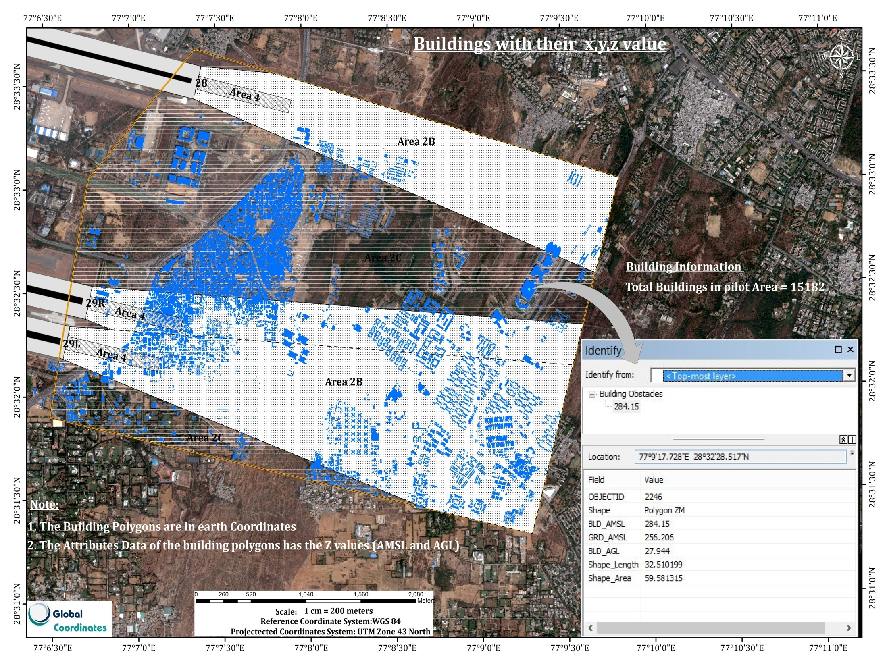

Slide 10
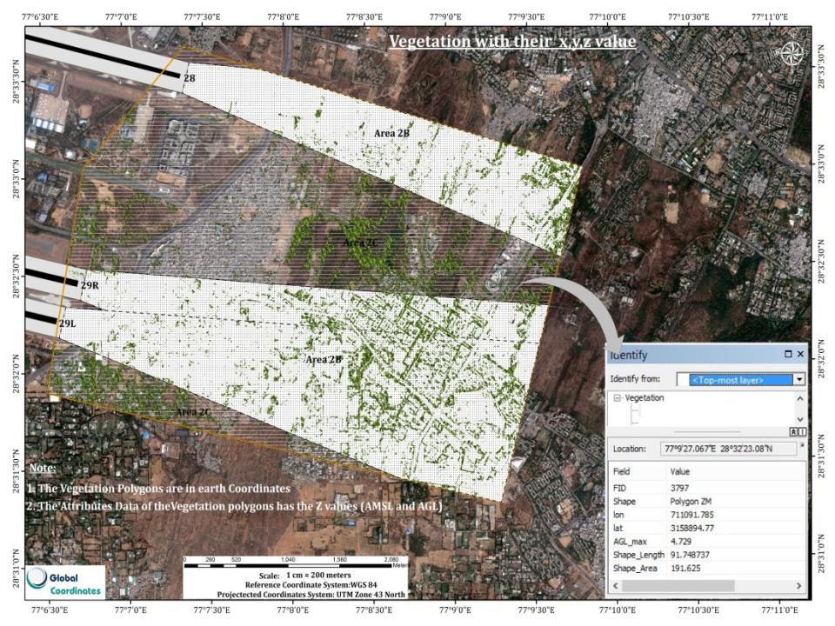

Slide 11
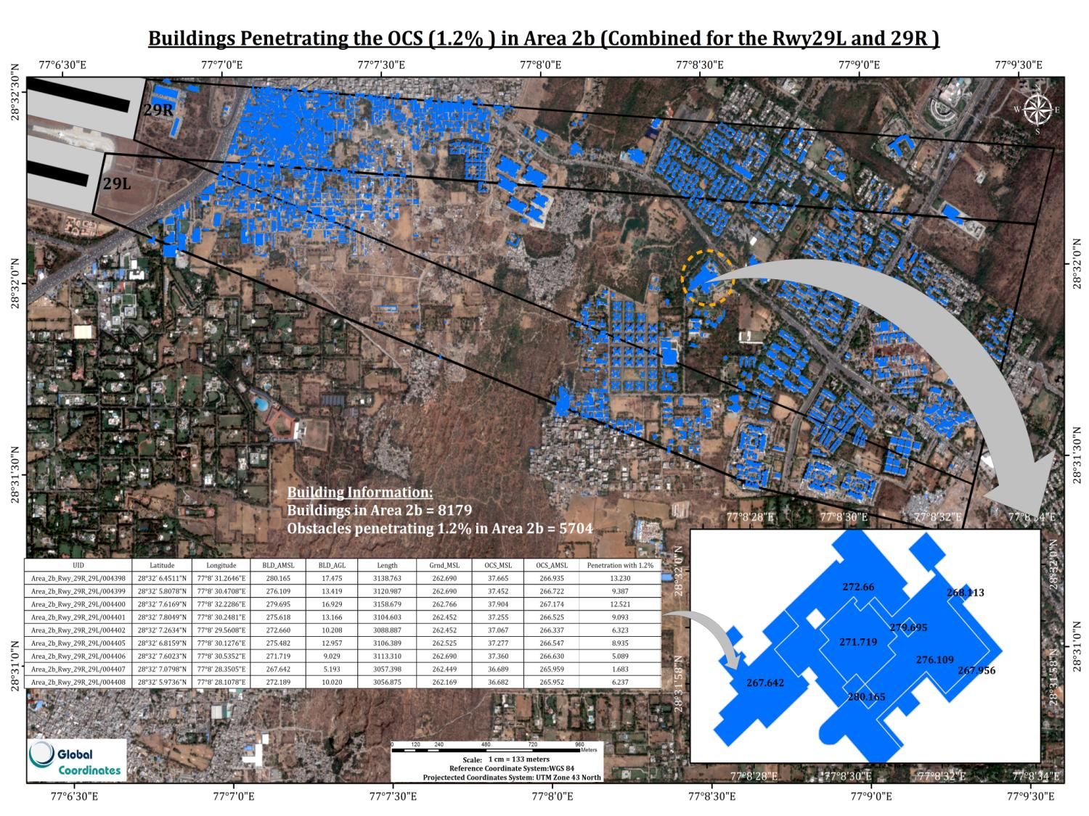

Slide 12
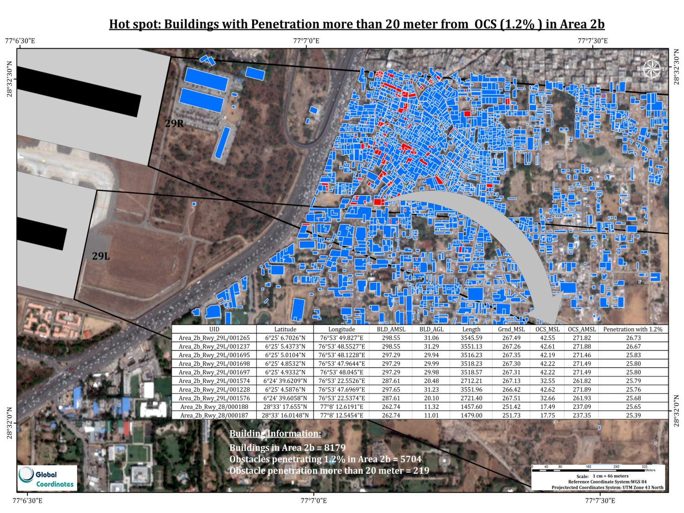


Slide 13
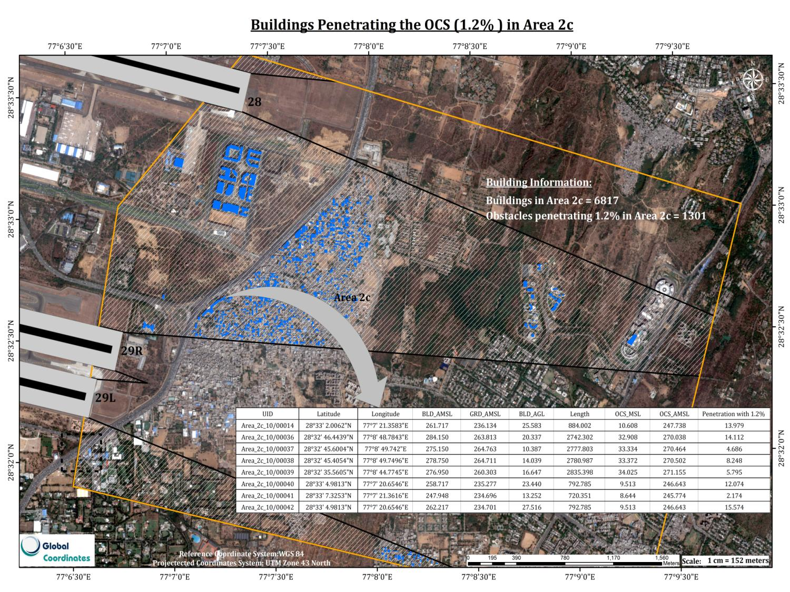

Slide 14
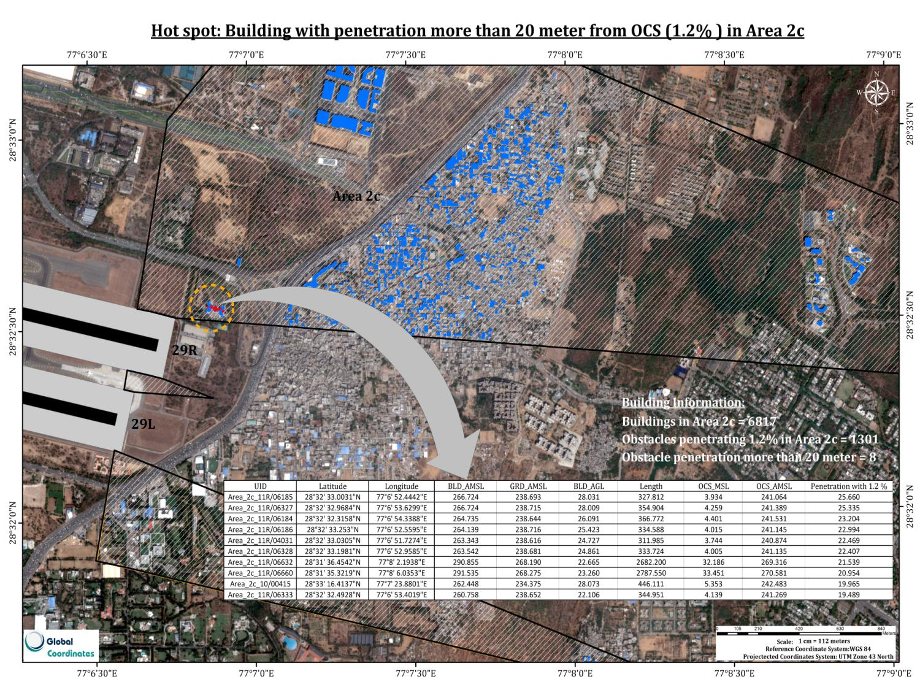

Slide 15
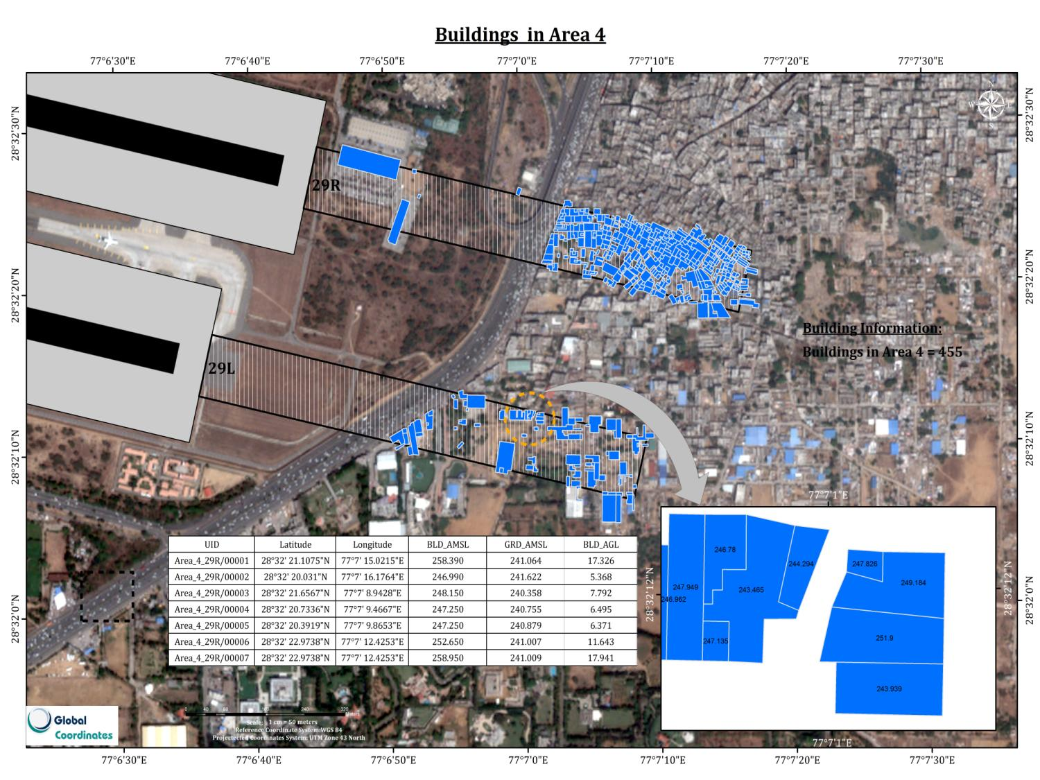


Slide 16



Slide 17
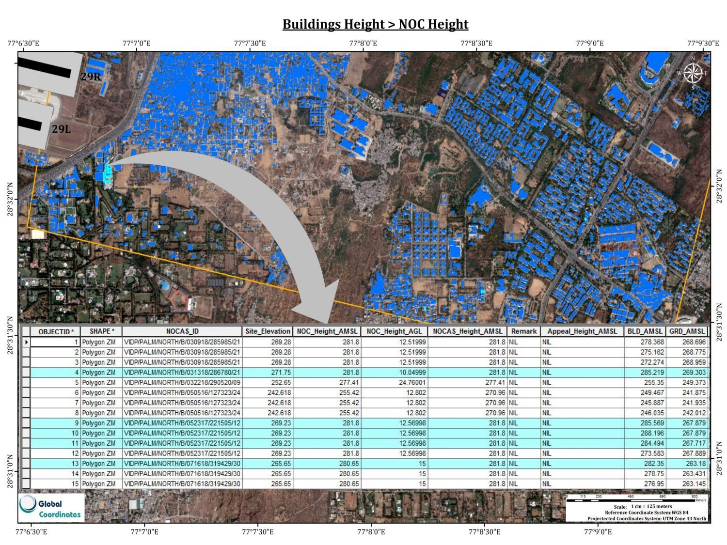

Slide 18
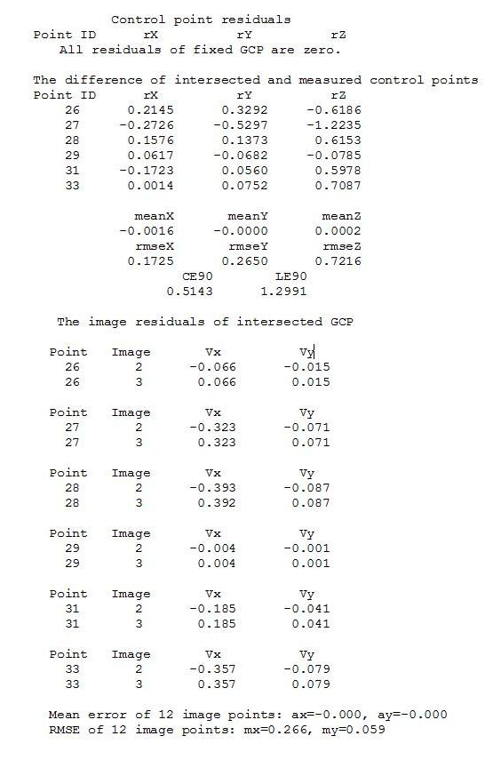
ACCURACY REPORT
Projected Coordinates of GCP points( Zone-43)
S.No. | Easting | Northing | Elevation ( EGM96) | Height (Ellipsoid)
26 | 711293.731 | 3159540.198 | 248.809 | 196.219
27 | 708716.556 | 3159778.807 | 249.08 | 196.57
28 | 710830.879 | 3158797.569 | 257.911 | 205.324
29 | 705653.388 | 3157285.975 | 237.846 | 185.394
30 | 706334.405 | 3158269.046 | 238.121 | 185.661
31 | 708730.971 | 3155821.847 | 273.945 | 221.38

Slide 19
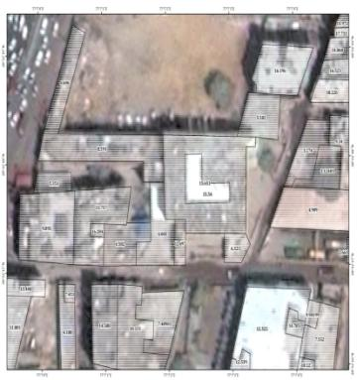

Ground verification
Building Capturing and Ground Height Observation
Survey Point No. | Longitude | Latitude | Ground Building Height | Height + Tolerance * ( Instrument) | Surveyed Building Height | Difference | Vertical Accuracy
Survey point 1 | 77°6' 58.9"E | 28°32' 16.9"N | 15.667 | 15.738 | 15.45 | 0.217 | Observed difference in value of surveyed Building Height and extracted Building Height = 0.689 m *Vertical Accuracy for Area 2 <= 3 meter
Survey point 2 | 77°7' 3.4"E | 28°32' 17.9"N | 15.175 | 15.245 | 15.65 | -0.475
Survey point 3 | 77°7' 3.09"E | 28°32' 18.4"N | 18.693 | 18.781 | 18.23 | 0.463
Survey point 4 | 77°7' 18.6"E | 28°32' 39.9"N | 15.388 | 15.459 | 15.48 | -0.092
Survey point 5 | 77°7' 58.8"E | 28°32' 54.4"N | 21.675 | 21.778 | 21.58 | 0.095
Survey point 6 | 77°7' 59.2"E | 28°32' 53.64"N | 24.642 | 24.76 | 23.56 | 1.082
Survey point 7 | 77°7' 55.7"E | 28°32' 38.5"N | 21.905 | 22.009 | 21.587 | 0.318
Survey point 8 | 77° 7'51.4"E | 28°32'15.0"N | 24.348 | 24.348 | 25.95 | -1.602
Survey point 9 | 77° 7'53.5"E | 28°32'12.4"N | 26.728 | 25.833 | 26.045 | 0.683
 |  |  |  |  |  | * Ref : ICAO Annexure 15, Appendix 8 , table No. 8.1
Building Height extracted from High resolution Satellite Imagery = 15.65 m
Building Height by Ground Survey= 15.170 m
Difference between Ground Survey and Capturing Height = -0.475 meter
Vertical Accuracy of e-TOD for Area 2 = +-3 meter (Ref: ICAO Annexure 15 – Appendix 8(Table 8.1)

